Slide 1
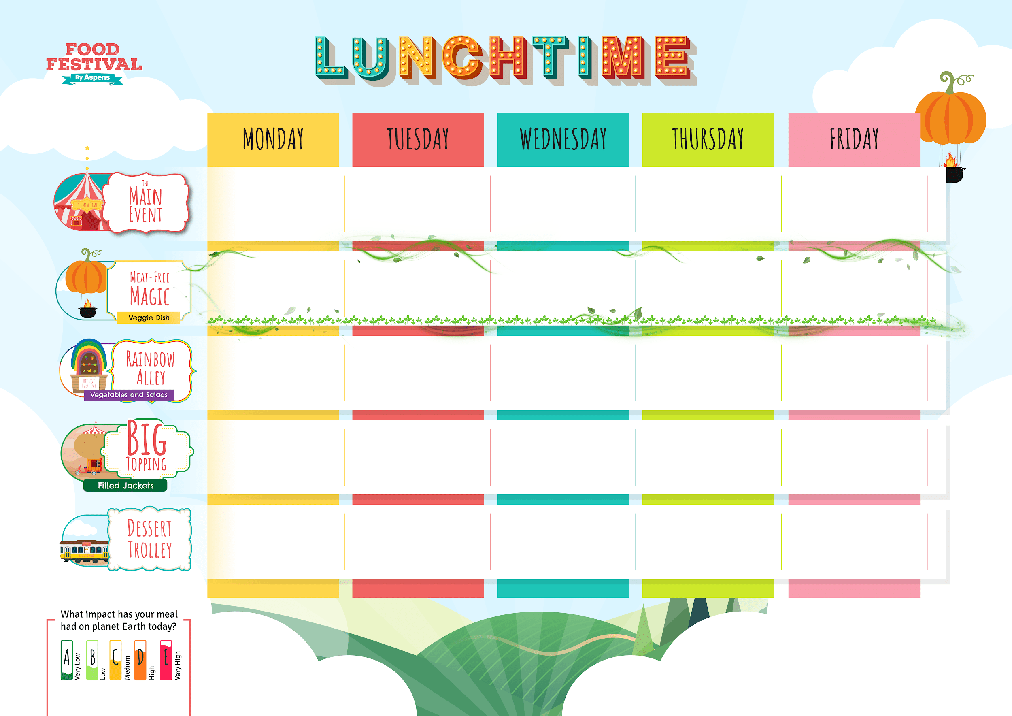














PRIMARY
TRADITIONAL
WEEK 1
Spring/Summer 2026
13/04/26, 04/05/26, 25/05/26, 15/06/26, 06/07/26, 27/07/26, 17/08/26, 07/09/26, 28/09/26, 19/10/26
Macaroni Cheese
Homemade Sausage
Roll with
Wholegrain
Rice Salad
Roast Chicken,
Stuffing, Skin on Roasties
and Gravy
Cottage Pie
Golden Fish Fingers
or
Salmon Fingers
and Chips
Mixed Bean Fajitas
with Wedges
Veggie Sausage Roll
with Wholegrain
Rice Salad
Cauliflower & Broccoli
Cheese Bake,
Skin on Roasties
and Gravy
BBQ Veggie Wrap
with Chips
Shepherdless Pie
Vegetable Sticks
Mixed Salad
Carrots and Peas
Mixed Greens
Baked Beans and Peas
Beans,
Cheese or
Tuna Mayo
Beans,
Cheese or
Tuna Mayo
Beans,
Cheese or
Tuna Mayo
Beans,
Cheese or
Tuna Mayo
Beans,
Cheese or
Tuna Mayo
Orange Squash
Cupcake
Strawberry Jelly
Peach Upside Down
Cake and Custard
Chocolate
Cinnamon
Cake
Banana Cookies
Topped Pasta
Daily salad bowl, freshly baked bread, Sandwiches and fruit
Hot Pasta topped with Homemade Tomato Sauce
& Cheese

Slide 2
PRIMARY
TRADITIONAL
WEEK 2
Spring/Summer 2026
20/04/26, 11/05/26, 01/06/26,
22/06/26, 13/07/26, 03/08/26,
24/08/26, 14/09/26, 05/10/26
Cheese and Tomato
Pizza Slice
with Wedges
Bangers
and Mash
Roast Gammon,
Skin on Roasties
and Gravy
Beef Whole Grain
Pasta Bolognese
Golden Fish Fingers
and Chips
Cheddar & Tomato
Puff Pastry Tart
with Wedges
Veggie Bangers
and Mash
Tomato & Lentil
Layer Bake,
Skin on Roasties
and Gravy
Veggie Whole Grain
Pasta Bolognese
Cheesy Bean Wrap
with Chips
Vegetables Sticks
Green Beans
and Sweetcorn
Carrots and Cabbage
Mixed Salad
Baked Beans and Peas
Beans,
Cheese or
Tuna Mayo
Beans,
Cheese or
Tuna Mayo
Beans,
Cheese or
Tuna Mayo
Beans,
Cheese or
Tuna Mayo
Beans,
Cheese or
Tuna Mayo
Lemon Shortbread
Fingers
Orange Jelly
Apple Sponge
and Custard
Oaty Peach
Crumble Slice
Chocolate
Krispie Date
Squares
Topped Pasta
Daily salad bowl, freshly baked bread, Sandwiches and fruit
Hot Pasta topped with Homemade Tomato Sauce
& Cheese

Slide 3
PRIMARY
TRADITIONAL
WEEK 3
Spring/Summer 2026
27/04/26, 18/05/26, 08/06/26,
29/06/26, 20/07/26, 10/08/26,
31/08/26, 21/09/26, 12/10/26
Cheese and Tomato
Pizza Slice
with Wedges
Creamy Chicken
Meatballs
and Rice
Roast Pork,
Skin on Roasties
and Gravy
Minced Beef
& Onion Pie
with Mash
Golden Fish
Fingers
& Chips
Macaroni Cheese
Vegetable
Ratatouille
with Rice
Med Veg Wellington,
Skin on Roasties
with Gravy
Root Vegetable
and Bean Stew
with Mash
Vegetable Fingers
with Chips
Vegetable Sticks
Sweetcorn and Cabbage
Carrots and
Green Beans
Mixed Greens
Baked Beans and Peas
Beans,
Cheese or
Tuna Mayo
Beans,
Cheese or
Tuna Mayo
Beans,
Cheese or
Tuna Mayo
Beans,
Cheese or
Tuna Mayo
Beans,
Cheese or
Tuna Mayo
Sweet Potato Chocolate Brownie
Raspberry Jelly
Treacle, Pear &
Ginger Cake
with Custard
Date and Sunflower
Seed Muesli Bars
Vanilla Cookies
Topped Pasta
Daily salad bowl, freshly baked bread, Sandwiches and fruit
Hot Pasta topped with Homemade Tomato Sauce
& Cheese

