Slide 1

Welcome to Year 1 Parent’s Meeting

Slide 2
Our Year 1 Team
Mrs Lucas
Mrs Bell
Miss Fulford/Mrs Gallagher/Mrs Mulligan

Slide 3

Behaviour at Sacred Heart
High expectations of children at all times.
Star listening
Slow Walking
Our class behaviour:
Notes:
Every child starts on a heart- Heart Values
Step 1 verbal warning Example “ , you are shouting out which is breaking our school rule of being respectful. This is your REMINDER. Please raise your hand in future.”
Step 2 White thinking cloud Example: “ , you are shouting out which is breaking our school rule of being respectful. This is your WARNING. Next time I have to speak to you it will be a blue cloud. Please raise your hand in future.”
Step 3 Blue Cloud Example: “ , you have chosen to continue to shout out which is breaking our school rule of being respectful. You have now received a Blue Cloud and will need to speak to me at breaktime.” Could be that they go to our partner teacher Miss. Owens
Step 4 Red circle , you are continuing to break the school rule of being respectful and have now received a Red
Circle. You will now spend your breaktime thinking about the choices you have made”. Particular, more serious behaviour e.g. swearing, physically hurting another child or adult, will warrant an immediate Red Circle - ‘time for reflection’.
At any stage a child can move back down.

Slide 4
Communication
Teachers are on the playground 8:40am each morning for quick messages
Communication (emails, telephone calls) all comes via the office.
Teachers can send out messages via Arbor.
Class and Whole School Newsletter is on the website.
Sign up to our schools Instagram account (see newsletter)
PLEASE CHECK ARBOR.

Slide 5
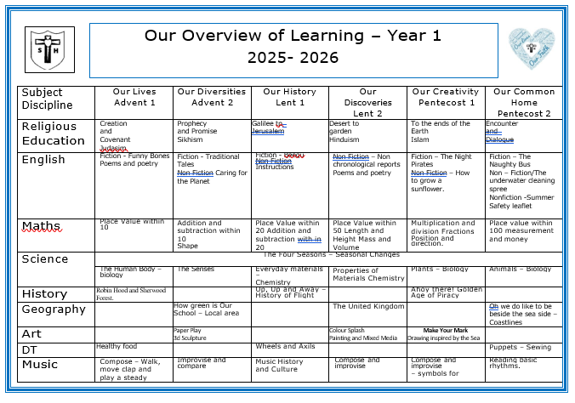
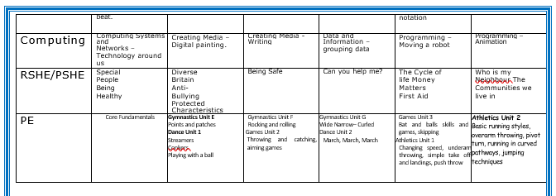
Yr1 Curriculum

Slide 6
Priorities in Year 1
Successful transition from F2.
Develop confidence, independence and resilience.
Kindness and friendship amongst peers.
Adapt to new routines and National Curriculum.
Improve Phonics for reading and writing.
Reading – Little Wandle decodable books.
Writing – developing sentence structure and key punctuation. Children begin to write with purpose.
Place value securely to 100.
Bonds within and to 10 and 20 securely.
Develop spiritual understanding of prayer and scripture.

Slide 7
Religious Education
Creation and Covenant
Judaism
Prophecy and Promise
Galilee to Jerusalem
Desert to Garden
To the end of the Earth
Encounter and Dialogue
Children will regularly learn about other faiths too, especially how other people celebrate their faith.

Slide 8
Reading
Reading lesson 3 times a week, focus on decoding, prosody and comprehension skills.
Small groups of children.
Books closely matched to phonic knowledge from LW.
https://www.littlewandle.org.uk/resources/for-parents

Slide 9
Reading at Sacred Heart
Reading in school
At certain points in the year, we will have reading competitions across the school.
Children are assessed on their comprehension, fluency and inference.
Reading for Pleasure
Teacher read at the end of the day
Opportunity to read towards the end of lessons.
Children can access the ‘Reading garden’
Reading at home
KS1 children should read a minimum of 3 times a week.
Please record their reading in their school diary.

Slide 10
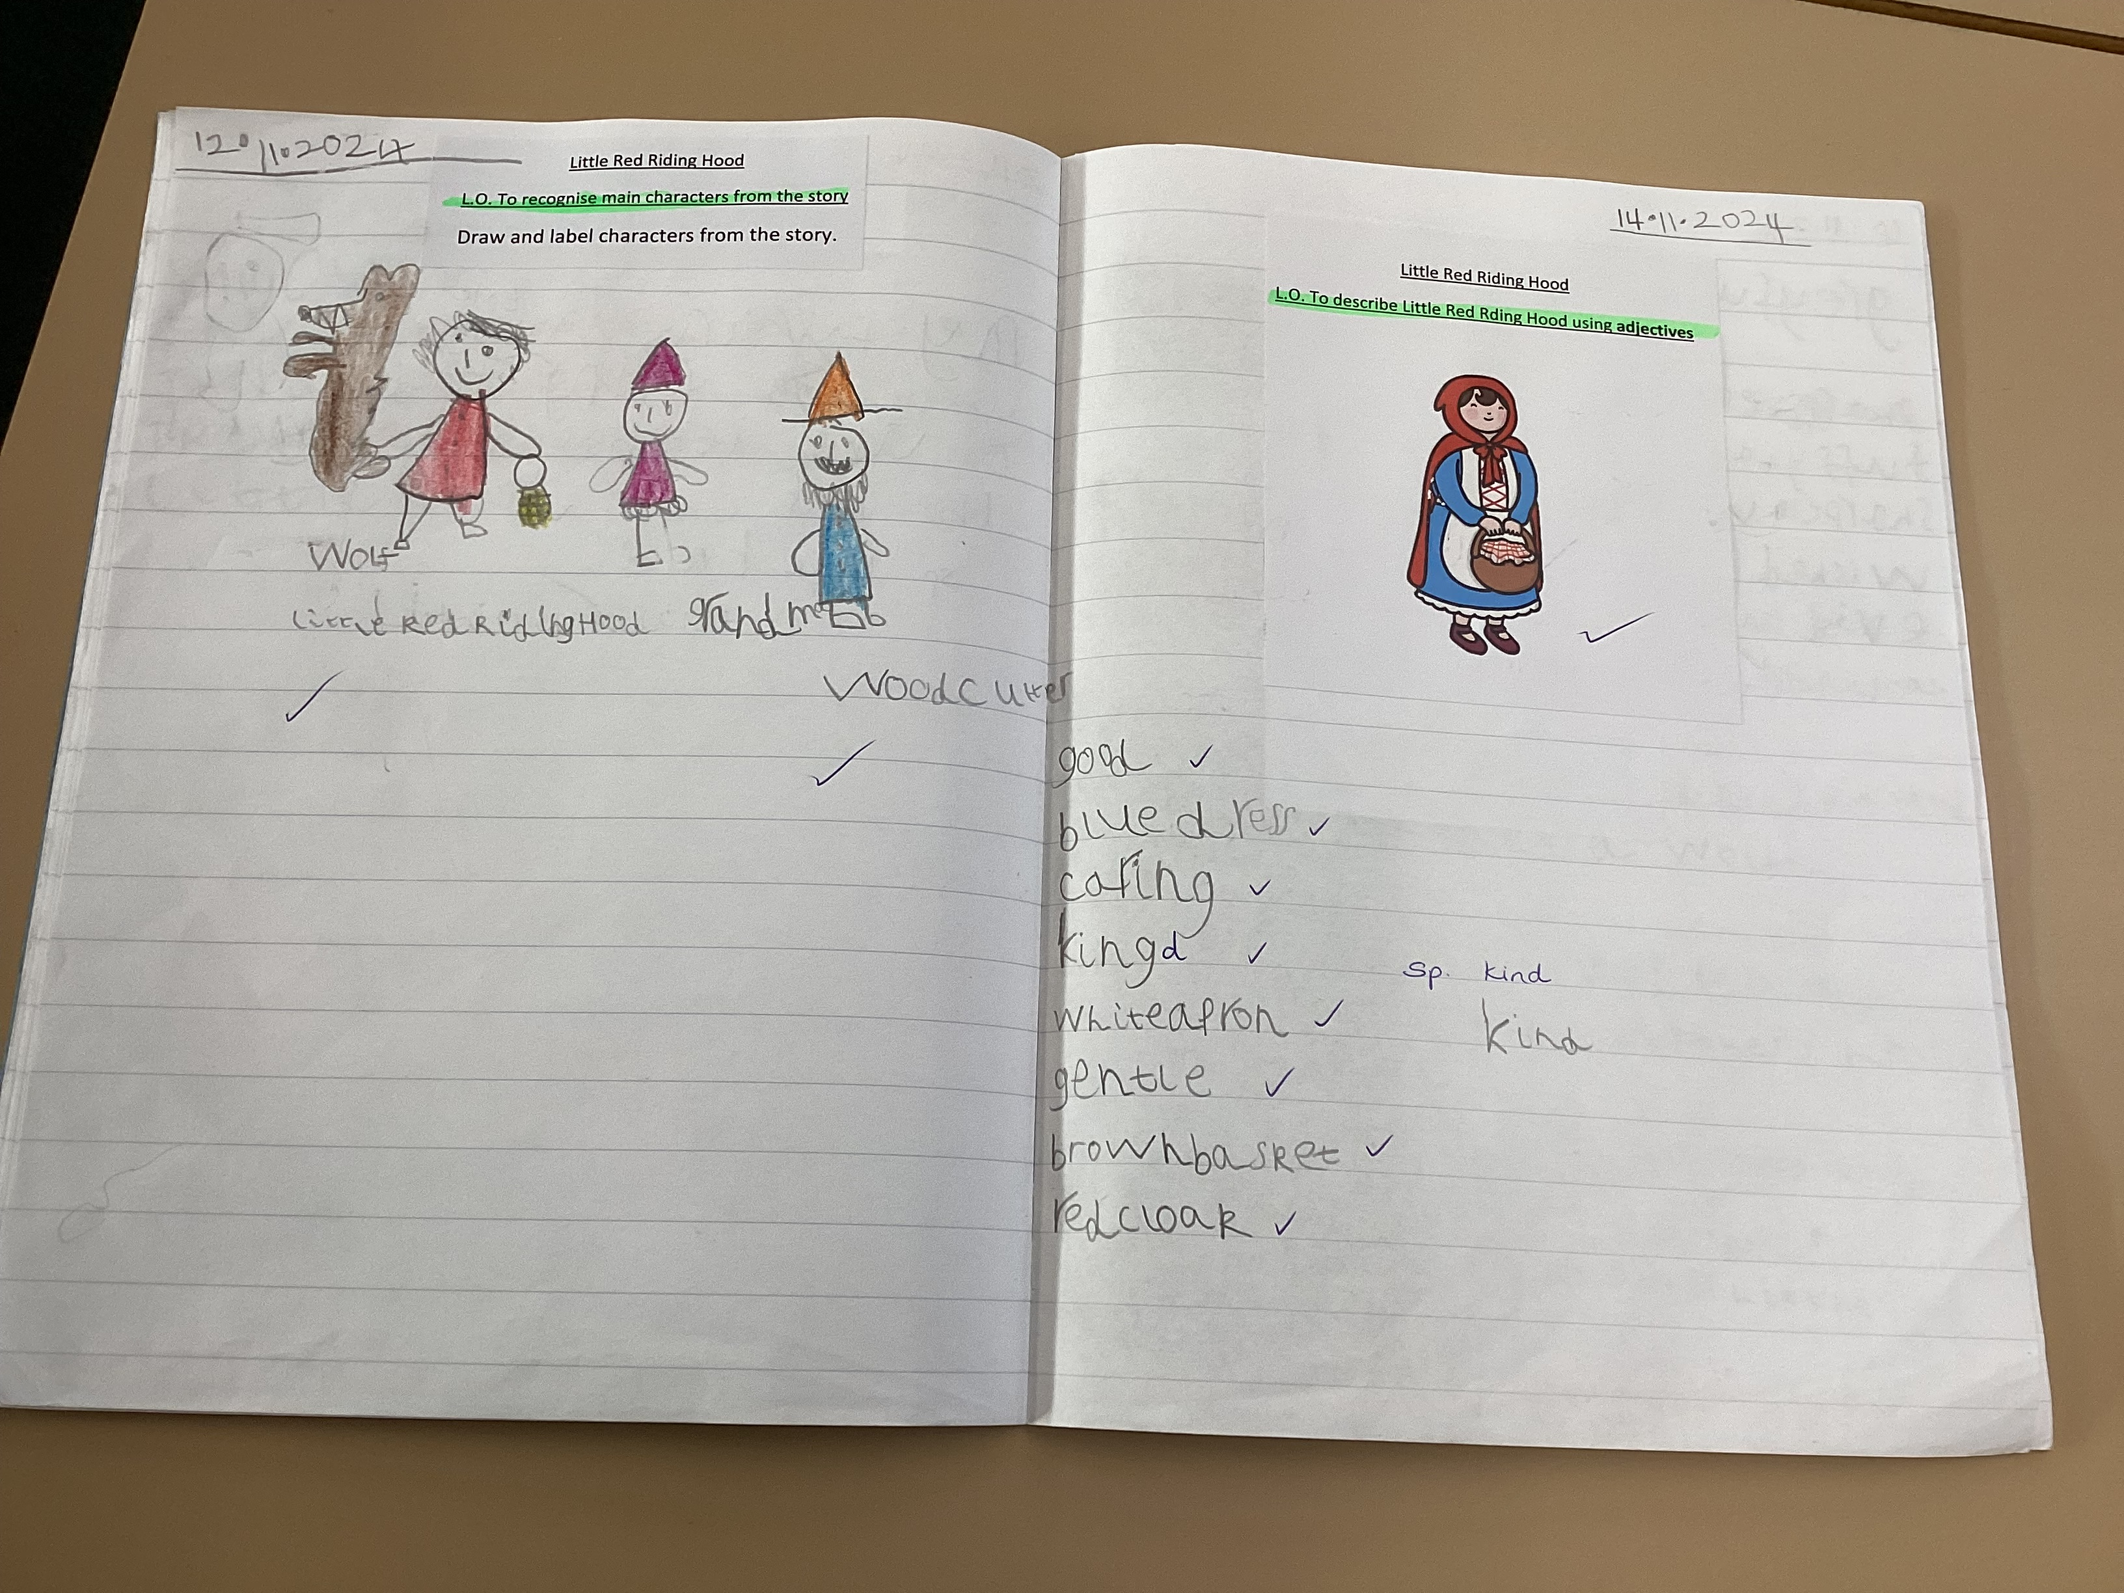
Writing at Sacred Heart
Writing in school
Handwriting lesson twice a week.
Writing lessons 3 times a week
Children are taught to form letters from the correct starting place.
Children are always aspire to have excellent presentation
Childre will respond to feedback

Slide 11
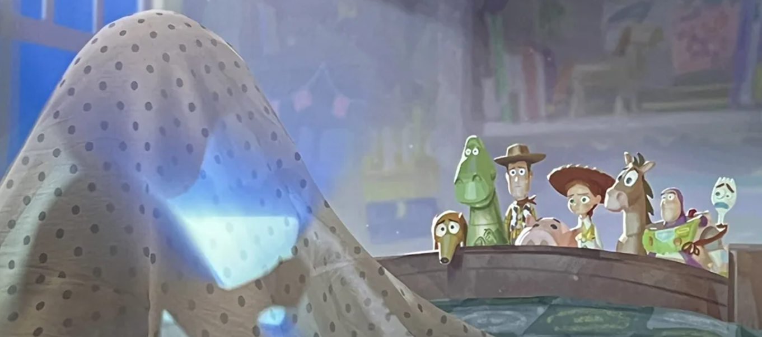
Writing at Sacred Heart
Writing at home
Children are encouraged to bring in any additional writing that they would like to share with the class.
Pupils may want to focus on developing their fine motor strength when engaging in play to develop the strength in their hands. This will support their writing!

Slide 12
Spellings
Homework is Phonics spellings, linked to phonemes taught is school.To help children build confidence and fluency, we ask that practice is shown in their homework books—though feel free to explore other fun ways to reinforce learning at home too!
Homework books should stay at home during the week so children can access their spellings easily and revisit them as needed.
Spellings are an important part of our homework routine, and regular practice really does make a difference.

Slide 13
How can you help at home?
White Rose – 1 minute maths app
Check correct letter/number formation; start from the correct starting position.
Writing shopping lists, diaries, letters in cards
Abstract mental maths such as quick addition/subtraction of bonds to 10 and 20 and for developing mental strategies.
Using analogue clocks in the home – what time is it or setting boundaries using an analogue clock to help them tell the time.
Reading – anything! Asking their opinions on what they have read – spotting mistakes in things is a great game to play!
Talking – talking about the news, what is happening in their life exploring opinions and thoughts and feelings.

Slide 14
Important things to know…
Names must be written in uniform, especially jumpers and PE sweatshirts.
PE Days are Tuesday and Wednesday
Homework be handed out on a Wednesday and will need to be in the follow Tuesday.
Trips and payments – please be punctual to avoid the office having to call you to chase the payment.
Clubs – places will be reserved once payment has been made.

Slide 15
Thank you
Thank you for coming today.
Positive communication between home and school so let us know of key information about wellbeing.
Attendance across the school is appearing much stronger.
Children are looking smart. Please remember black school shoes must be worn with school uniform. No trainers please.

