Slide 1
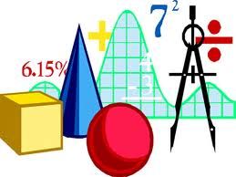
History:
What we
will be
learning:
Maths:
World War 2 – A Child’s War:
Significant dates, people and places
Life for children
The Holocaust and life in concentration camps
Impact of the war on Nottingham and society
Decimals
Fractions, decimals and percentages
Converting units of measurement
Fractions, decimals and percentages
Area, perimeter volume
Algebra
Ratio
We will also have time each week to practise times tables, problem solving and general arithmetic skills.
Geography:
Developing countries in Africa:
Definition of a developing country
How physical, social and political factors affect the development of a country
What we can do to help.
Art and D&T:
Henry Moore – Creating mood in drawing
Come Dine with Me – Creating an African meal
English:
RE:
Computing:
In the first half term, we will be studying a picture book called The Lion and the Unicorn about a young boy who is evacuated to the countryside in WW2.
In the second half term, we will be focusing on non-fiction and writing instructions and persuasive letters.
Galilee to Jerusalem
Desert to Garden
Creating media – webpage creation
Data and information – introduction to spreadsheets
Science:
Evolution and Inheritance
Light
Music:
French:
Trailblazers
Samba music
Lent term 2025
World War 2

