Slide 1

Teaching reading at Sacred Heart
Parent workshop: Phonics and early reading in F1, Reception - Phase 2 and Year 1- Phase 5 (Autumn 2)
Notes:
For this presentation, you will need to download and print out the following resources and information for parents:
Phase 2 grapheme information sheet – Autumn 1
the parent handout ‘Your child’s reading journey – Reception Autumn term’
the Phase 2 and 3 grapheme mat
the Little Wandle Progression overview
‘Phase 2 tricky words: Reception Autumn term – Information for parents and carers’ – or parents can access this in the ‘For parents’ area of the Little Wandle website.
You will need a flipchart and access to the Little Wandle and Collins websites.
You may also wish to have a copy of the Little Wandle Glossary to hand (in Getting started/Teaching).

Slide 2
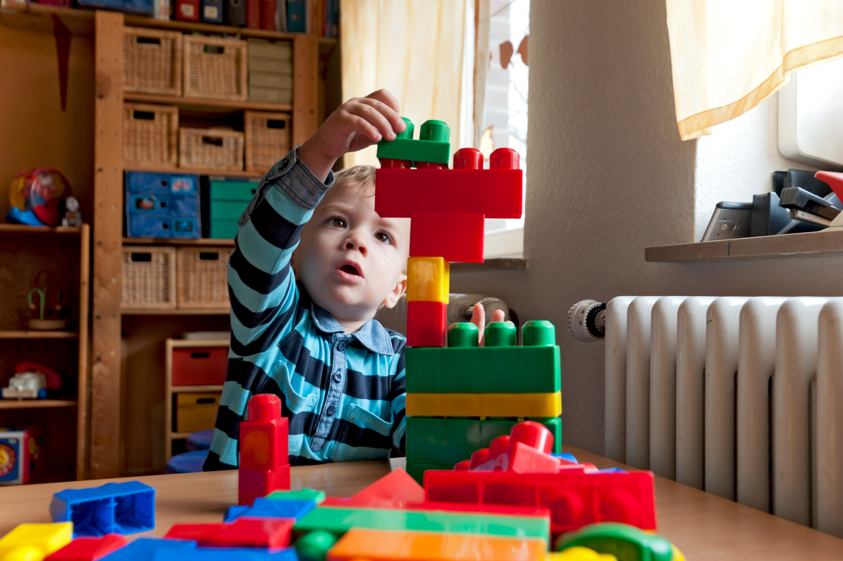
Little Wandle Foundations for Phonics
Our school has chosen to use the
Little Wandle Foundations for Phonics programme to give every child the best possible start to their reading journey.
We build the foundations for children to succeed with phonics in Reception.
We do this using Little Wandle’s Tuning
into sounds and Rhyme time activities.
Notes:
Suggested script:
All early years settings follow the government's EYFS statutory framework. We provide learning for your children following the guidelines set out in the framework.
For one of the prime areas of learning, Communication and Language, we have chosen to use Little Wandle Foundations to support your child's learning.
Read the slide.

Slide 3
What helps children get ready for phonics?
Research tells us that there are important skills that children need to practise to help them learn phonics.
Nursery is where we practise these skills. Formal phonics teaching begins in Reception.
Let’s look at what we focus on in Nursery and what you can do at home, too.
Notes:
Suggested script:
So, phonics involves children learning to connect sounds or phonemes to letters.
In order to prepare them for this, we need to help them recognise what a phoneme is.

Slide 4

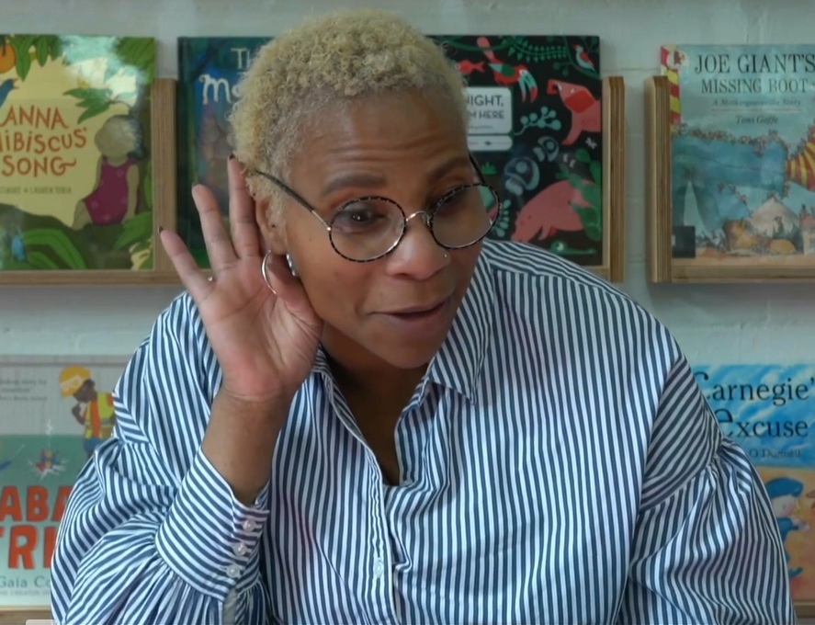
Listening games
In our setting, we:
talk about different types of sounds
play listening games,
for example, Voice sounds.
At home, you can:
draw your child’s attention to different sounds around them, for example, ‘Listen to the loud noise! It sounds like an engine.’
Notes:
Suggested script:
For children to learn anything well, they need to listen.
As you can imagine, this is particularly true for learning to hear sounds!
Let's watch a video of a game that we play with the children called Voice sounds.

Slide 5

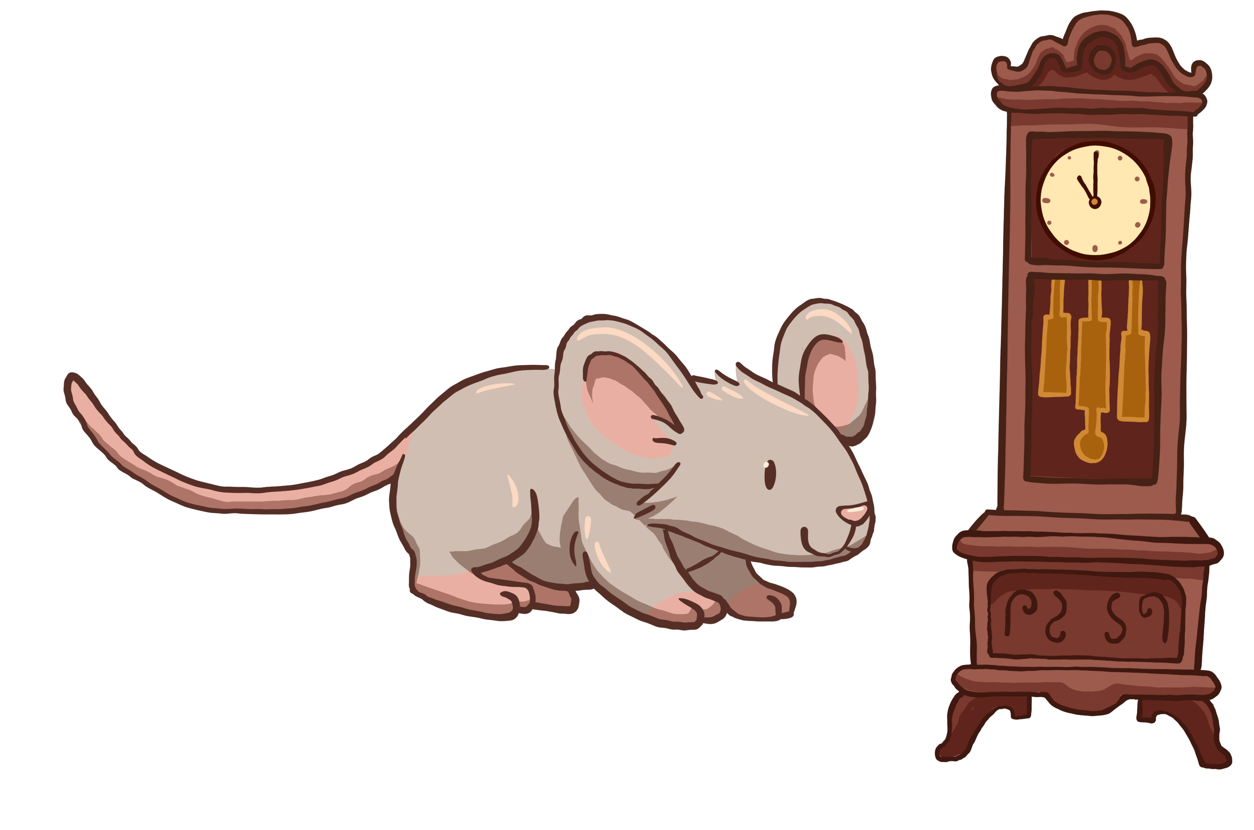
Songs and rhymes
In our setting, we:
sing rhymes regularly
leave gaps at the end of the line for children to complete the rhyme, for example, ‘Hickory dickory dock, the mouse ran up the ______.’
At home, you can:
read lots of rhymes and sing songs
pause for your child to complete the rhyme
make up silly rhymes, for example, ‘Get your coat,
you little goat! So we can leave the house, little mouse!’
Notes:
Suggested script:
Songs and rhymes are a great way to increase children's awareness of rhyming, which is a key part of phonological awareness.
What's more, research has shown that children who learn nursery rhymes with their caregivers go on to become better readers.
This is only true when they learn these rhymes with an adult – please avoid only letting your child watch nursery rhymes on screens as it doesn't have the same impact.

Slide 6

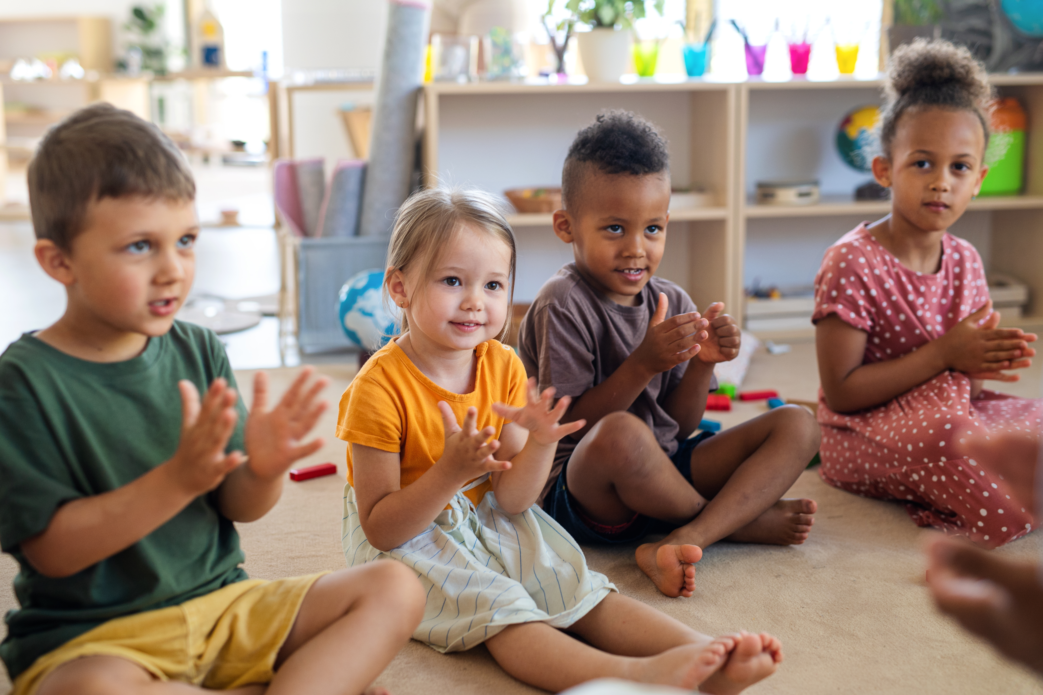
Hearing syllables
In our setting, we:
clap the number of syllables in different words
highlight long and short words.
At home, you can:
clap the syllables of words
talk about long words, for example,
‘Ooh, that’s a long word! Let’s clap it out.’
work out how many syllables
there are in your family names.
Notes:
Suggested script:
Another part of phonological awareness is syllables. Syllables are the smaller units within words.
For example, the word 'hello' has two syllables – clap as you say 'hel’ and 'lo’.
You can also explore the number of syllables in your names, for example, “My name has __ syllables.” (clap the syllables in your name). “How many syllables are there in your name?”
If children can hear the syllables within words, it will help them to read and write longer words when they get into Reception. So it is important to give them lots of practice.

Slide 7
Hearing syllables
In our setting, we:
clap the number of syllables in different words
highlight long and short words.
At home, you can:
clap the syllables of words
talk about long words, for example,
‘Ooh, that’s a long word! Let’s clap it out.’
work out how many syllables
there are in your family names.
Notes:
Suggested script:
Another part of phonological awareness is syllables. Syllables are the smaller units within words.
For example, the word 'hello' has two syllables – clap as you say 'hel’ and 'lo’.
You can also explore the number of syllables in your names, for example, “My name has __ syllables.” (clap the syllables in your name). “How many syllables are there in your name?”
If children can hear the syllables within words, it will help them to read and write longer words when they get into Reception. So it is important to give them lots of practice.

Slide 8
Phonics is:
making connections between the sounds of our spoken words and the letters that are used to write them down.
Notes:
Slide purpose:
To provide a simple definition of phonics
Suggested script:
So what is phonics?
Read the slide.
It sounds complicated but it really isn’t!
Let's learn some important words that will help you understand phonics ...

Slide 9
Terminology
Blend
Phoneme
Segment
Grapheme
Year 1 also use
Digraph
Adjacent consonant
Trigraph
Split digraph
Notes:
Slide purpose:
To give simple definitions of key terminology
Notes:
Explain what each word means – use the Glossary to help.

Slide 10
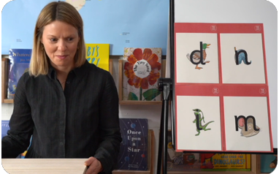
In F2 this term we are teaching Phase 2
These are the first group of letters and sounds your child will learn.
We start teaching from week 2 of Reception.
The lessons are fun, interactive, engaging and have been designed to gradually build over time.
Notes:
Slide purpose:
To introduce Phase 2
Notes
Read the slide.

Slide 11
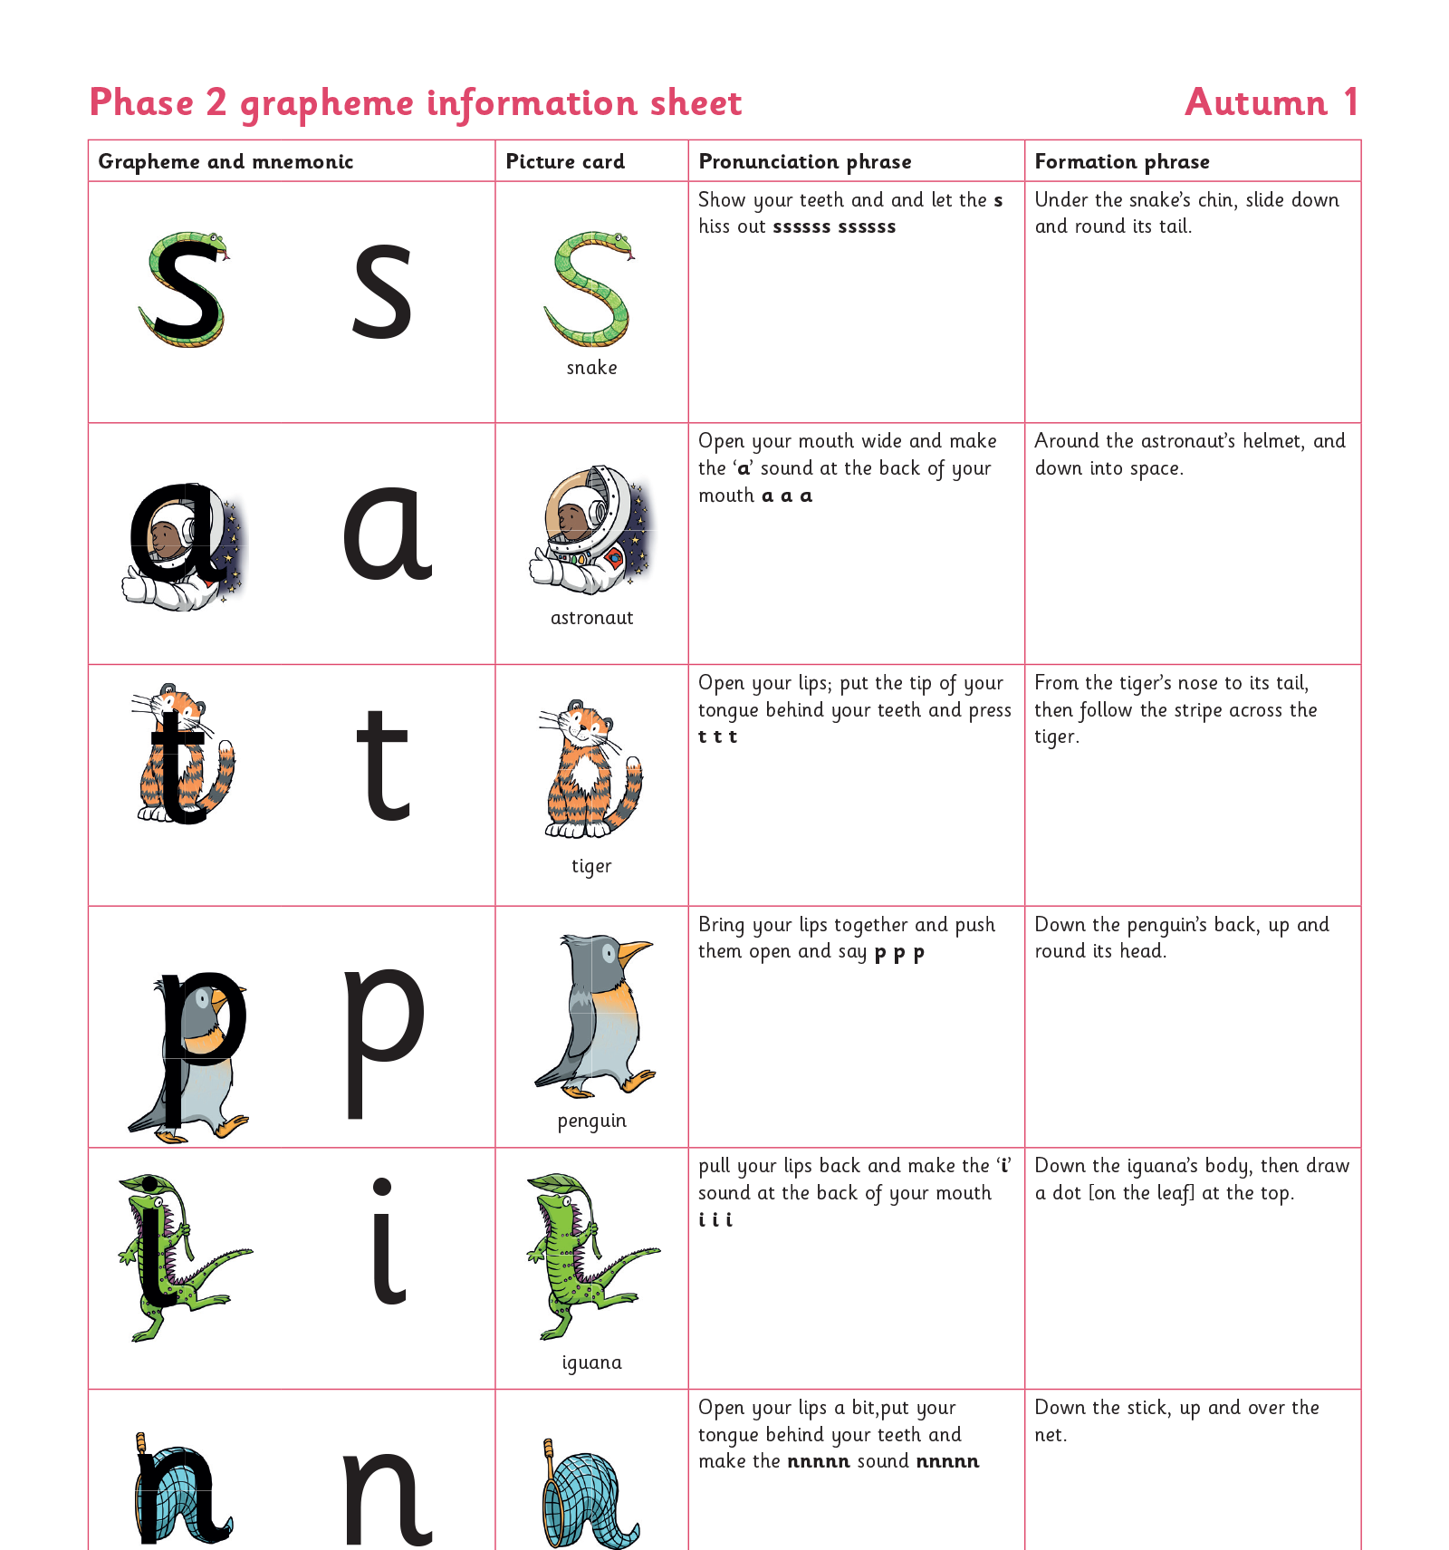
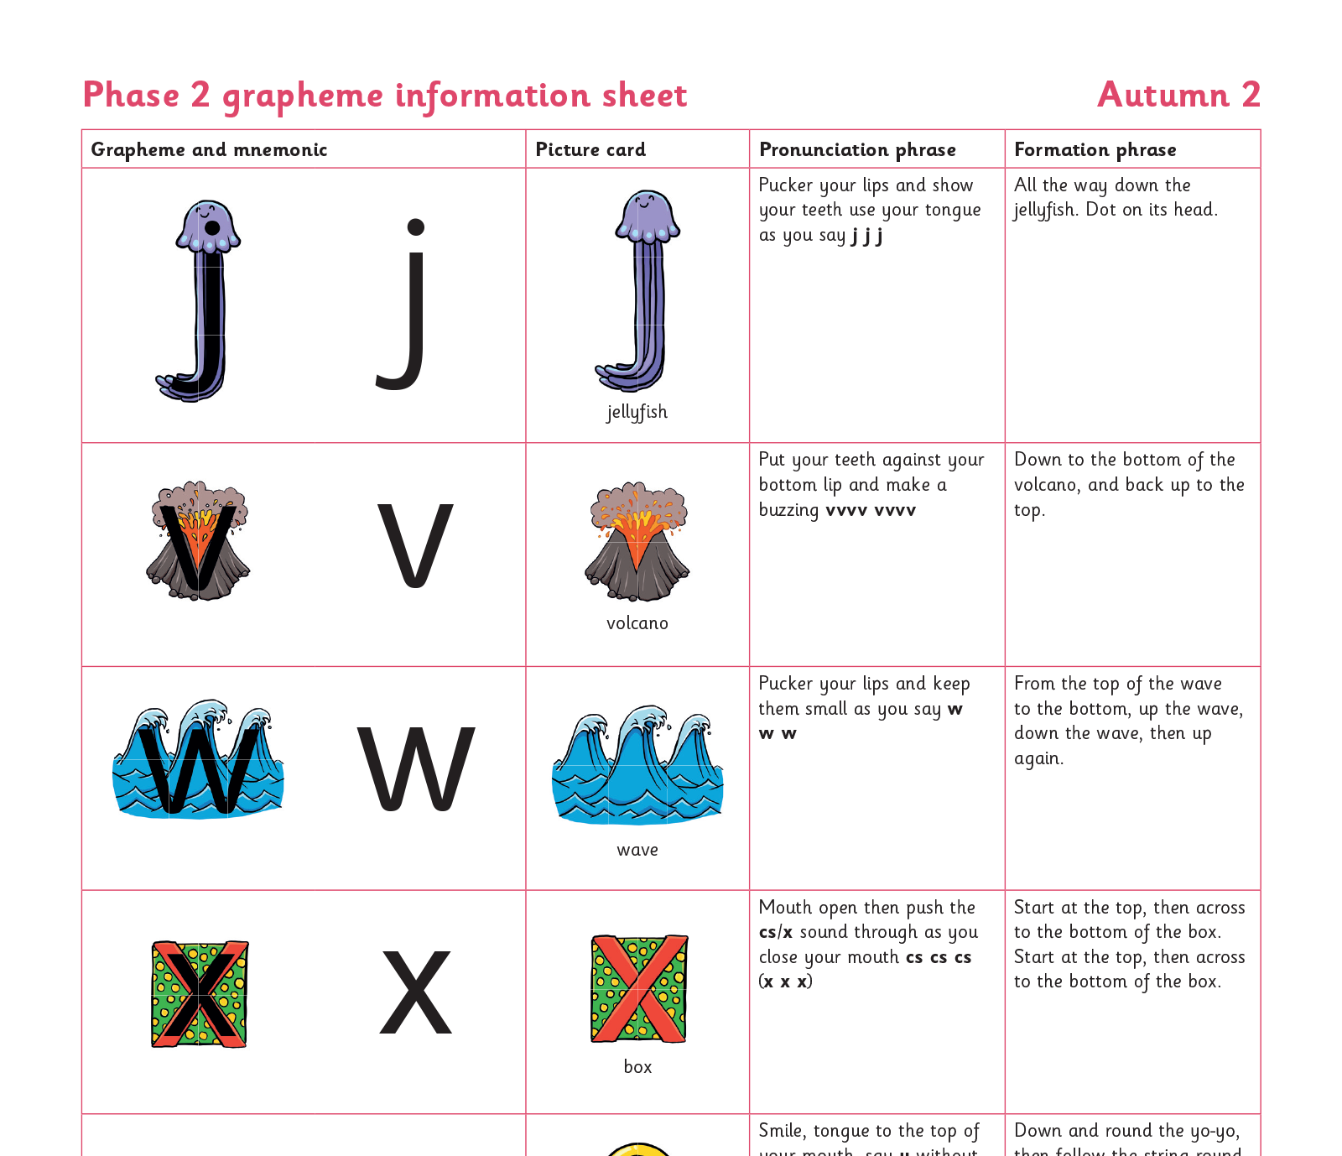
We teach Phase 2 in this order
Notes:
Slide purpose:
To provide an overview of the Phase 2 sounds
Suggested script:
We usually teach four new sounds a week and have a review lesson on a Friday.
You will get a list of the sounds that we are learning to have at home. This will help you with letter formation (handwriting) and pronunciation.
Give the Phase 2 grapheme information sheet for Autumn 1 to parents.

Slide 12
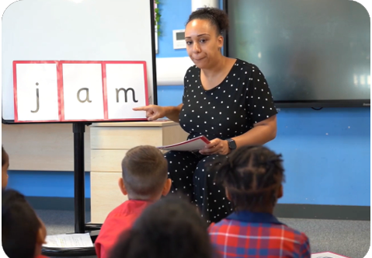
We teach blending so your child learns to read
Teacher-led blending is taught throughout Phase 2.
Our aim to is to teach every child to blend by Christmas.
We will inform you if your child needs additional practice.
Notes:
Slide purpose:
To introduce blending
Suggested script:
Teacher-led blending is teaching children how to blend, directed and demonstrated by the teacher.
It is repeated daily in the Autumn term.

Slide 13
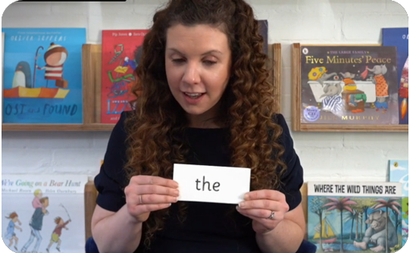
Tricky words
These words have unusual spellings e.g. he, the, was.
They are taught in a systematic way.
Children are now learning to read the Phase 2 tricky words: is, I, the, put, pull, full, as, and, has, his, her, go, no, to, into, she, push, he, of, we, me, be.
Notes:
Slide purpose:
To introduce tricky words
Notes:
Read the slide.
You may wish to give parents a copy of the document ‘Phase 2 tricky words: Reception Autumn term – Information for parents and carers'.

Slide 14
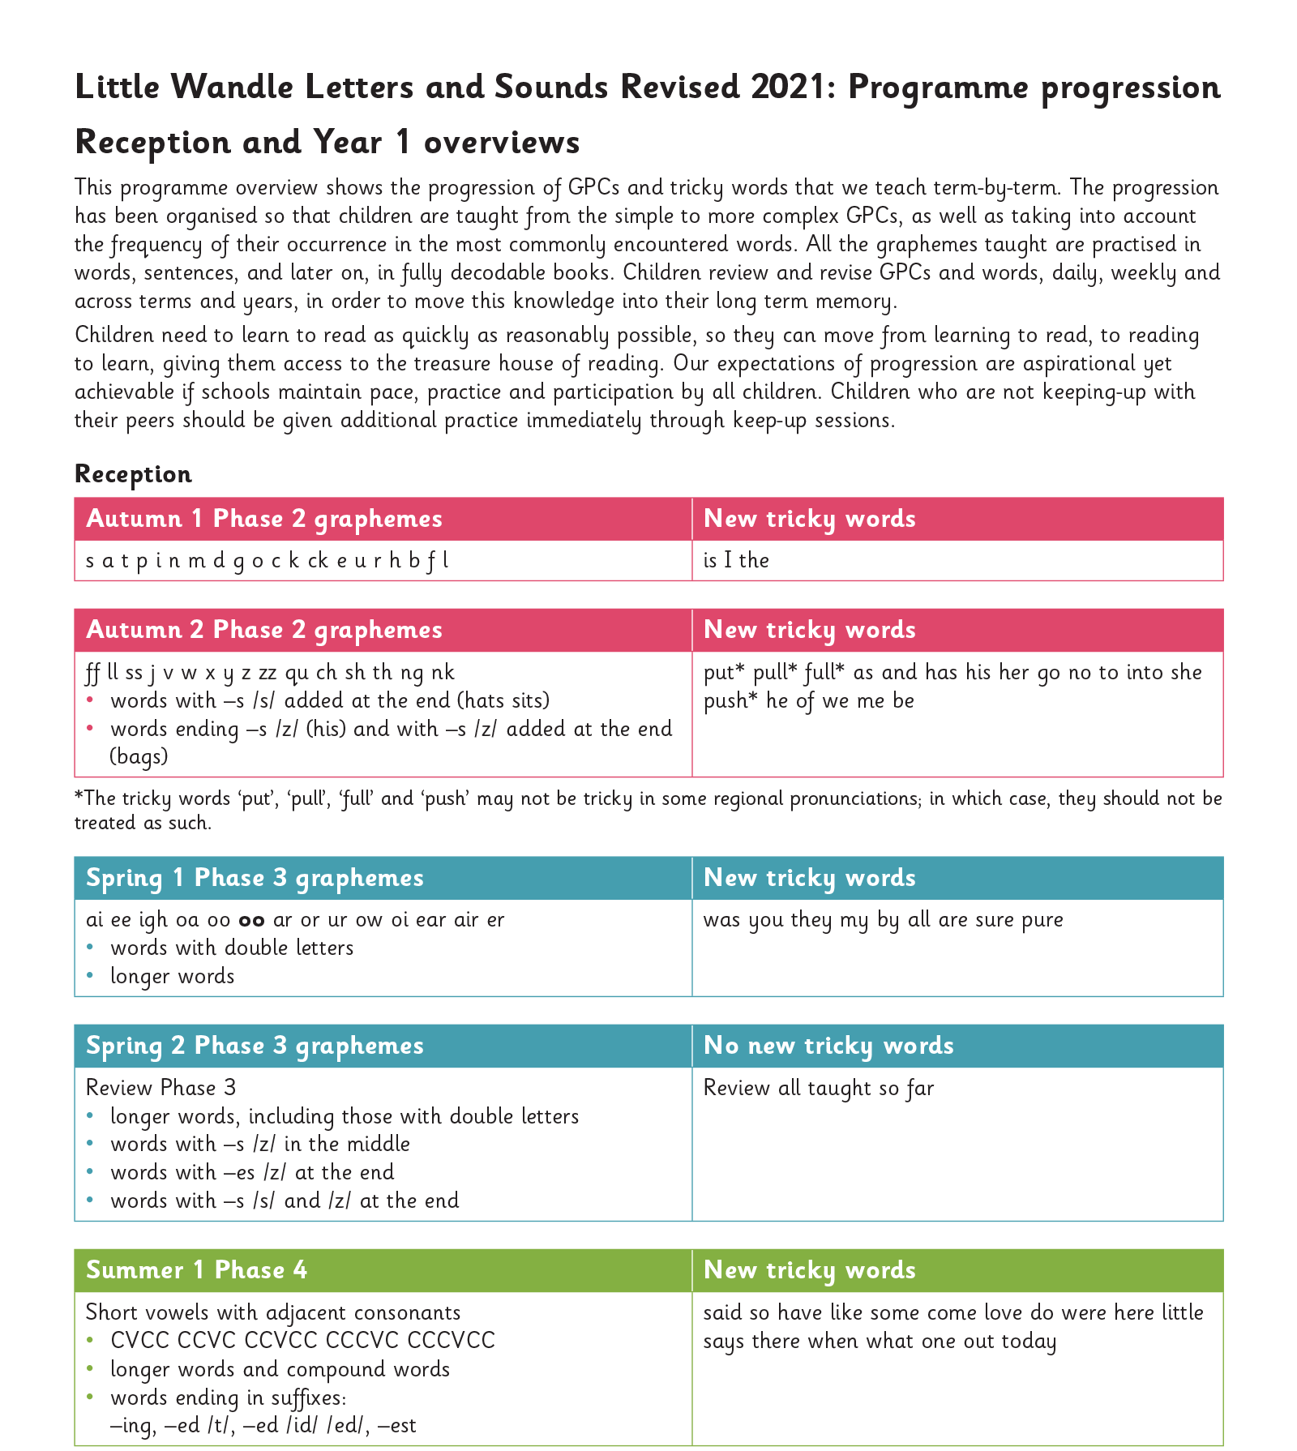
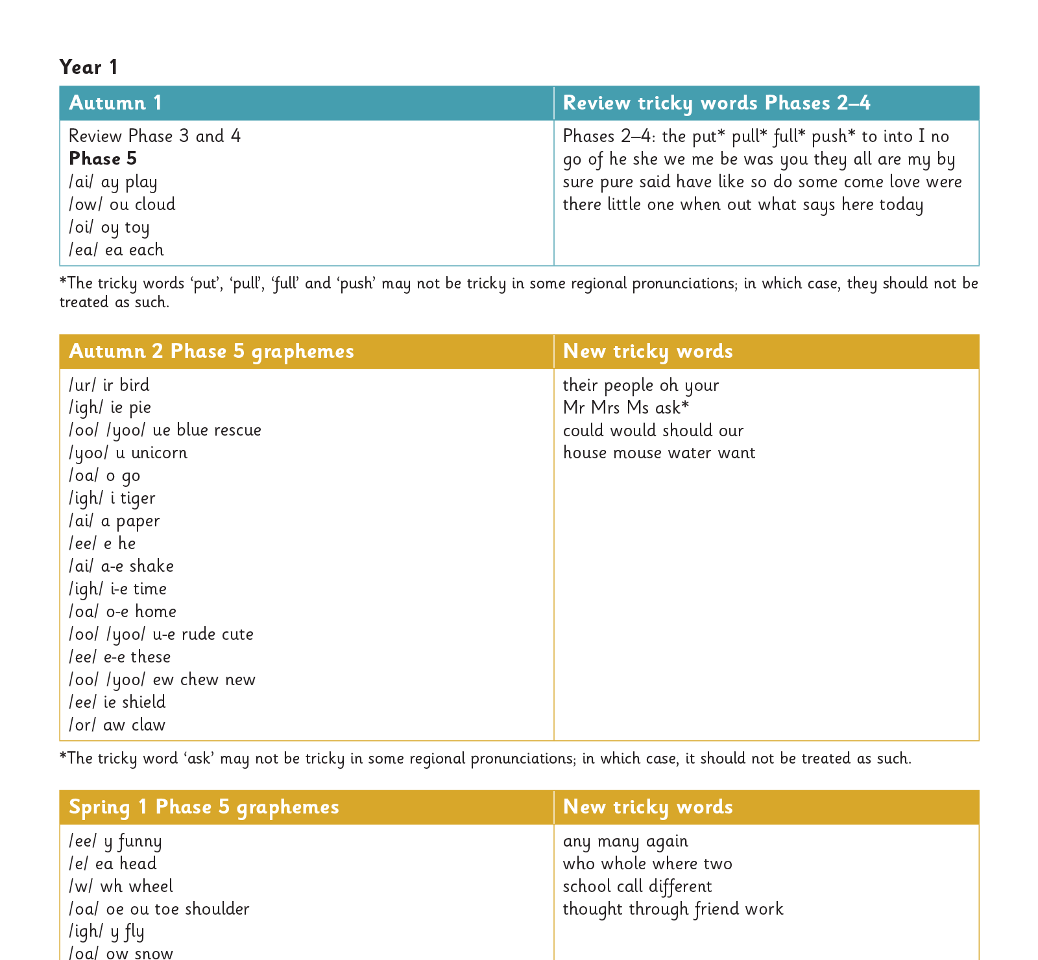
Our progression
Notes:
Slide purpose:
To provide an overview of the whole programme’s progression
Suggested script:
We will work our way through the whole Little Wandle Programme until your child can read fluently.

Slide 15
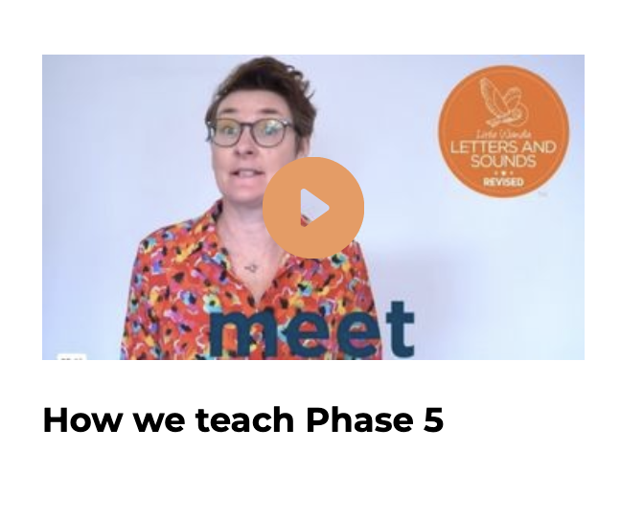
In Year 1 this term we are teaching Phase 5
In Phase 5 children learn:
new graphemes for the sounds they already know
that the same grapheme can have alternative pronunciations.
The ‘Grow the code’ lessons support children with reading and spelling these alternative spellings.
Notes:
Slide purpose:
To provide an overview of Phase 5 'Grow the code’
Suggested script:
The children learn the last set of graphemes, including ones with alternative pronunciations.
Play the video which explains how we teach Phase 5. (The first 20 seconds are a repeat of the ‘How to say the sounds’ video but then goes on to explain what the alternative graphemes are for the sound /ai/.)
They will also learn to ‘Grow the code’ where children will explore different ways of spelling the same phoneme and reading the same grapheme. This means that they are able to read increasingly challenging words and books.
Children learn strategies so that they can distinguish between the same grapheme, different phoneme and the same phoneme but different grapheme. ‘Growing the code’ will support children as they get older with accurate spelling.

Slide 16
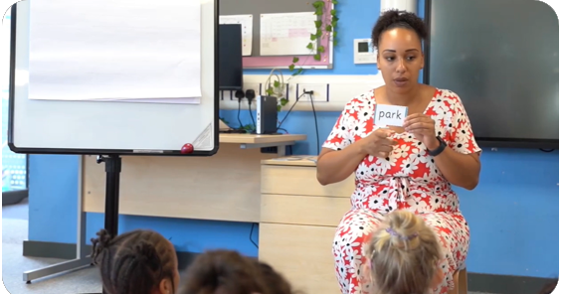
Reading words
Children will be able to:
blend independently
blend in their heads with increasing fluency and confidence.
They will also begin to distinguish between different phonemes/graphemes.
Notes:
Slide purpose:
To introduce the strategies that children need to become fluent readers
Suggested script:
Most children will now be confident using the strategy ‘blend in your head’ to build their fluency.
Blending in your head means children say the sounds quietly in their heads and then read the whole word out loud.
If your child is struggling with a word, encourage them to blend in their head.
Children are also taught to spot digraphs in words before reading the word as a whole. This also helps their developing fluency.
Show parents how to spot digraphs in words. Show a word such as ‘head’. Point to ‘ea’ and say: This is a digraph. Model reading the word: h-ea-d head. Show another word e.g. ‘bread’. Ask parents to spot the digraph and read the word: b-r-ea-d bread.
Eventually, reading becomes automatic and children will be able to read words that they know fluently.
Fluency is the ultimate goal of phonics teaching and fluent reading is explicitly taught.

Slide 17

Reading and spelling in F2

Slide 18

How do we teach spelling?
Say the word.
Segment the sounds.
Count the sounds.
Write them down.
Notes:
Slide purpose:
To provide an overview of spelling
Notes:
Model the process above on a flipchart for the parents to see.
Show the process with a Phase 2 word, e.g. pin, dig, hug.

Slide 19
Reading and spelling in Yr 1

Slide 20

Spelling
This term, your child will be taught how to spell words every day using the graphemes they have been taught so far.
They will practise writing a dictated sentence.
Handwriting is referred to but is taught at other times of the day.
Notes:
Slide purpose:
To introduce spelling
Suggested script:
In Year 1, there are increasingly challenging words to spell, e.g. longer words, compound words, plurals. This all matches the Little Wandle sequence of learning.
The children will also practise writing a dictated sentence on a Friday. Their teacher will say the sentence, show them how to write it and then ask the children to write it independently.
Handwriting phrases learned in Reception are referred to during the lesson, but the specific practice of handwriting is taught separately.

Slide 21
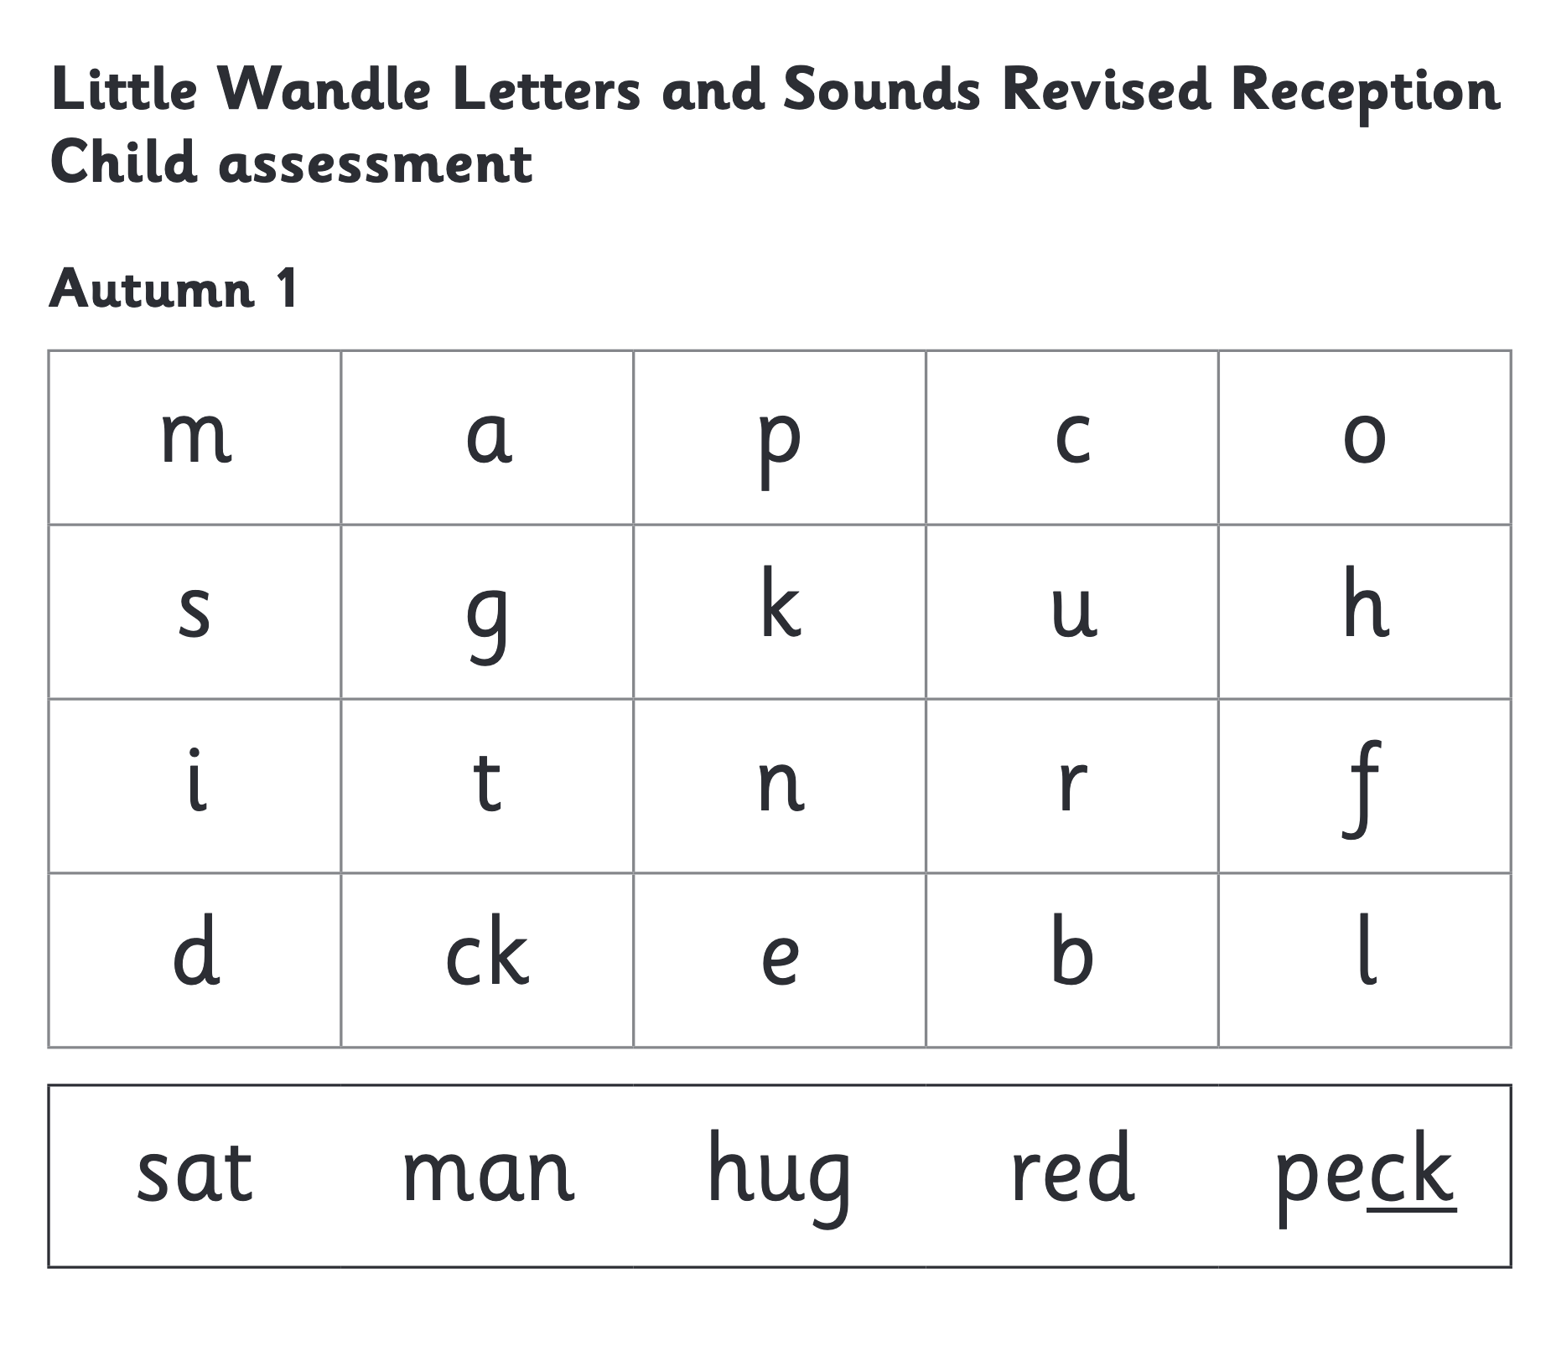
We use assessment to match your child the right level of book
Notes:
Slide purpose:
To introduce book matching
Suggested script:
We assess your child every six weeks to check progress.
Any child who needs extra support has Daily Keep-up sessions planned for them.
You will have noticed that your child’s books become more challenging as they secure more phonics.

Slide 22
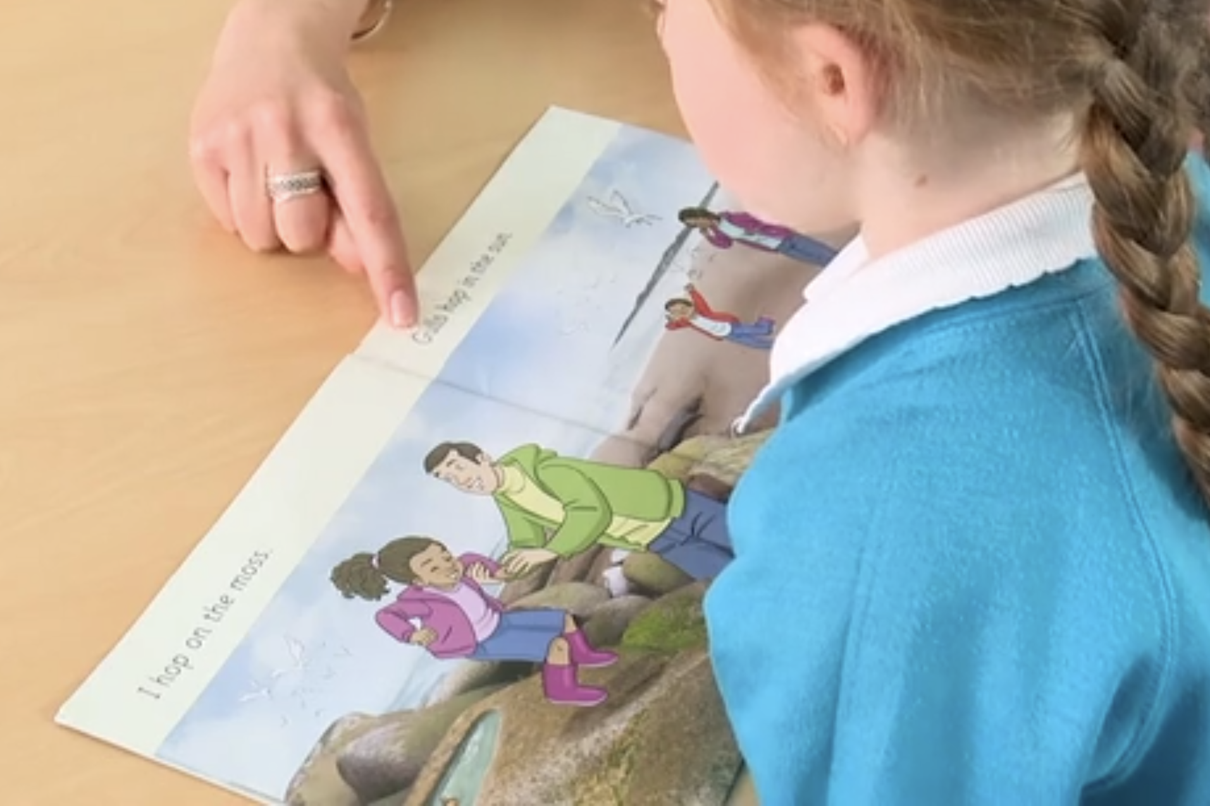
Reading a book at the right level
This means that your child should:
know all the sounds and tricky words in their phonics book well
read many of the words by silent blending (in their head) – their reading will be automatic
only need to stop and sound out about 5% of the words by the time they bring the book home – but they should be able to do this on their own.
Notes:
Slide purpose:
To provide an overview of book matching
Suggested script:
Once your child is reading a Phase 3 book, we encourage them to ‘blend in their heads’ – you will remember that this is one of the strategies we use to help develop children to become fluent readers. (Blending in your head means children say the sounds quietly in their heads and then read the whole word out loud. Eventually, this will become automatic and children can read words that they know fluently.)
We will always communicate with you if we feel that your child is not blending accurately enough yet and needs additional support.

Slide 23
How do we practise reading in books?
Reading practice sessions are:
timetabled three times a week
taught by a trained teacher/teaching assistant
taught in small groups
children in Reception will bring a decodable book home by first week of Advent 2 half-term.
Notes:
Slide purpose:
To introduce decodable books
Suggested script:
The children read the same book three times in a week.
The first time we work on decoding (sounding out) the words, the second time we work on prosody which is reading with expression – making the book sound more interesting with our story-teller voice or our David Attenborough voice – and the third time we look at comprehension.
We read the books three times at school because we want to develop the fluency.
The more children see words, the more they begin to read them automatically without having to sound them out.

Slide 24
How do we find the right book for your child?
Notes:
Slide purpose:
To introduce book matching
Suggested script:
We assess your child every six weeks to check progress.
Any child who needs extra support has Daily Keep-up sessions planned for them.

Slide 25
Reading at home

Slide 26

Books going home
Notes:
Slide purpose:
To introduce the process and format for reading at home
Suggested script:
As well as the ‘learning to read’ book that your child will bring home they will also bring home a book for sharing with you.
This shared book is SO important. This is how we are going to give them the WILL to read.
Please read with your child as often as you can – at least once a day if possible.

Slide 27
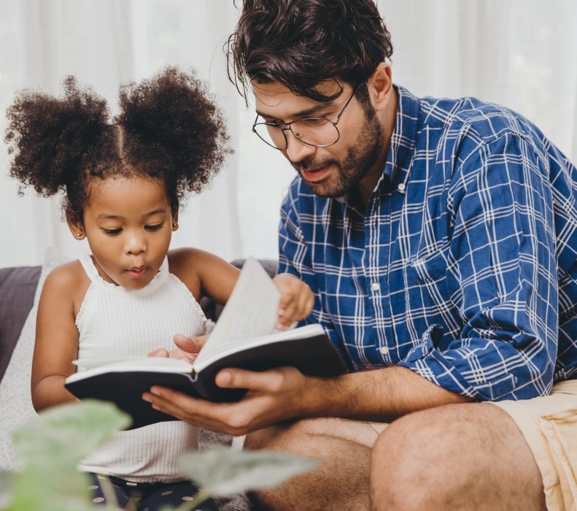
The most important thing you can do is read with your child
Reading a book and chatting had a positive impact a year later on children’s ability to…
understand words and sentences
use a wide range of vocabulary
develop listening comprehension skills.
The amount of books children were exposed to by age 6 was a positive predictor of their reading ability two years later.
Parental involvement in the development of children’s reading skills: A five-year longitudinal study (2002) Senechal, M. and Lefvre, J
Notes:
Slide purpose:
To summarise key takeaways
Suggested script:
Celebrate your child’s success at school.
Make time for reading at home!

Slide 28
One of the greatest gifts adults can give is to read to children
Carl Sagan
Notes:
Slide purpose:
Key takeaways/final message
Notes:
Read the quote.

Slide 29
Big Cat Collins
Logging in
Your child has been set up to access the Big Cat eBook Library with a username and password
Reading the eBooks
Once you have logged in you will see the Library screen, which contains the Big Cat eBooks assigned to your child by their teacher. To open a book, click on the cover

Slide 30
