Slide 1
Welcome to
Year 1 Parents Meeting!
Mrs Lucas
Mr Cordes Friday
Miss Marvin
Notes:
Ensure you have the correct year group on here and the correct staff names.
Welcome the parents, explain that today you are going to run through what class X will be learning this year, where things can be found on the website, how they can help at home.
Explain that after the presentation, you are happy to speak to parents about individual children if they have any concerns or worries.

Slide 2
Behaviour Policy
Sacred Heart Behaviour Curriculum
Politeness Pets
Star Listening
Slow walking
SPEAK
Notes:
In May 2023 we introduced our behaviour curriculum - we introduced slow walking PETS, star listening and this has had an impact in class learning time. However, in June 2024 we reviewed the curriculum and strategies with the children and staff. The pupils and staff agreed that we needed more visuals to help the children see where their behaviour was. We worked with the children and developed the cloud system.
Every child starts everyday on the heart – these represent out heart values of hardworking, enthusiastic, aspirational, respectfulness and togetherness. This is the least we expect off every child.
The start is for exceptional behaviour – always on the heart, helping others, going above and beyond in politeness, effort, care or the school and care of others.
Explain the clouds
Straight to blue for calling a name
Straight to red for hurting others
Three reds and SLT becomes involved and a behaviour plan is created.
Racist and homophobic incidents will automatically involve SLT.

Slide 3
Communication goes through the office.
Teachers can send out messages.
Newsletter is on the website.
PLEASE CHECK ARBOR.
Communication
Notes:
Last year, we worked with a parent party, staff and governors to have a new communication policy. This was to reduce frustration of Dojo messages being missed and so at all times a second person had oversight of messages coming into school.
Arbor is a full communication system. You can send messages and teachers can send messages. Messages sent to the office will be acknowledged and are passed onto the member of staff the same day. If it is an urgent matter, the class teacher will get back to you however if it is non- urgent the class teacher has three days to respond.
Newsletters are sent out every month via email and placed on the website under newsletters. These give you important information regarding what is happening or happened in school and had a diary dates page which is updated monthly.
Please do check ARBOR for messages.

Slide 4
Royal blue school jumper
Grey skirt/trousers/shorts
Blue gingham dress for summer
White/grey socks
Suitable school shoes
Suitable coat for the weather
School reading folder
PE days – non branded PE kit
White tee shirt
Navy/black pe shorts
Plimsoles/trainers for outdoors
School uniform
Put your child’s name on everything!
Notes:
In May 2023 we introduced our behaviour curriculum - we introduced slow walking PETS, star listening and this has had an impact in class learning time. However, in June 2024 we reviewed the curriculum and strategies with the children and staff. The pupils and staff agreed that we needed more visuals to help the children see where their behaviour was. We worked with the children and developed the cloud system.
Every child starts everyday on the heart – these represent out heart values of hardworking, enthusiastic, aspirational, respectfulness and togetherness. This is the least we expect off every child.
The start is for exceptional behaviour – always on the heart, helping others, going above and beyond in politeness, effort, care or the school and care of others.
Explain the clouds
Straight to blue for calling a name
Straight to red for hurting others
Three reds and SLT becomes involved and a behaviour plan is created.
Racist and homophobic incidents will automatically involve SLT.

Slide 5
OUR TOPICS
Ourselves/Our bodies
Our local area
The History of Flight
The United Kingdom
Piracy
Coastlines of the UK
Notes:
Add in what are your main topics during the year in here.

Slide 6
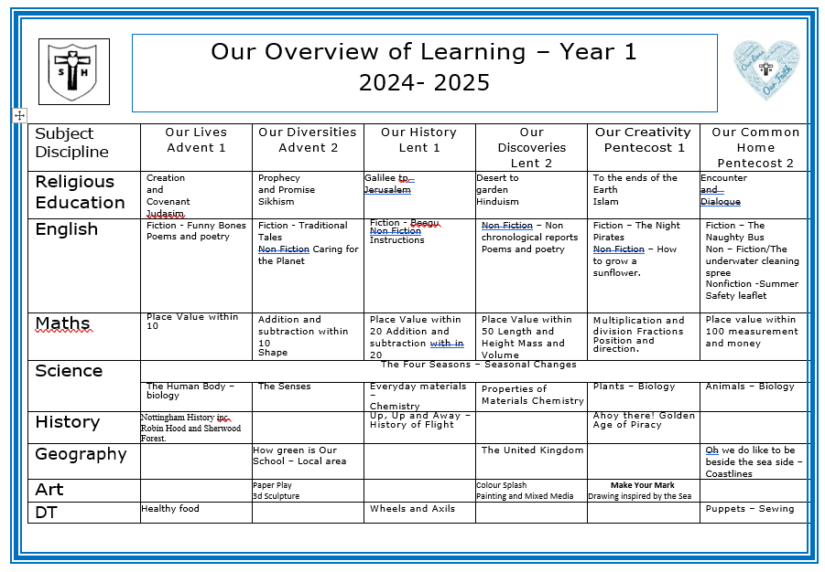
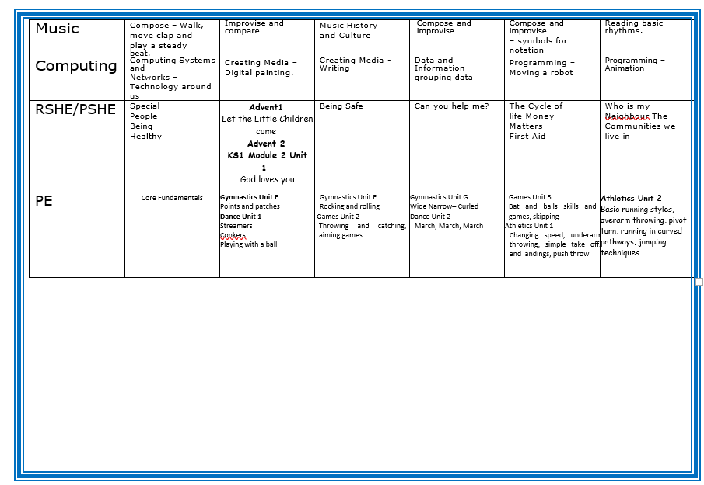
Notes:
Add in snips of your OWN overview. Explain that this can be found on your class page and that further information can be found on the curriculum pages.

Slide 7
Religious Education
We are currently trialing the new Religious Education Directory.
This is a new knowledge-based curriculum that will come into effect nationally in September 2026.

Slide 8
Every year, the pupils will experience the following units of RE
Advent Term
Creation and Covenant
Judaism
Sikhism
Prophecy and Promise
Lent Term
Pentecost Term
Galilee to Jerusalem
Hinduism
Desert to Garden
To the end of the Earth
Islam
Encounter and Dialogue
You will notice an increase in world faiths, this is to link in with British Values, promoting tolerance and respect for different faiths and cultures. In each world faith we teach, we will look at how the faith shows care in the community.
Notes:
Read slide.
We are currently working on parent guides for each year group which will be shared on the schools website.
Explain that the all pupil voice and a national survey completed by the Children’s commissioner has clearly demonstrated that they pupils want to learn more about world faiths too.

Slide 9
MATHS
Our Maths Lessons
Times Tables
Flash Back 4
Fluency
Problem solving and reasoning
White Rose
Tough Ten
Times tables Rock stars will be set starting with 2s, then 10 then 5s.
Notes:
Explain what a lesson looks and feels like – resources we use – importance of problem solving and reasoning every lesson
Edit where needed for year group/ phase.

Slide 10
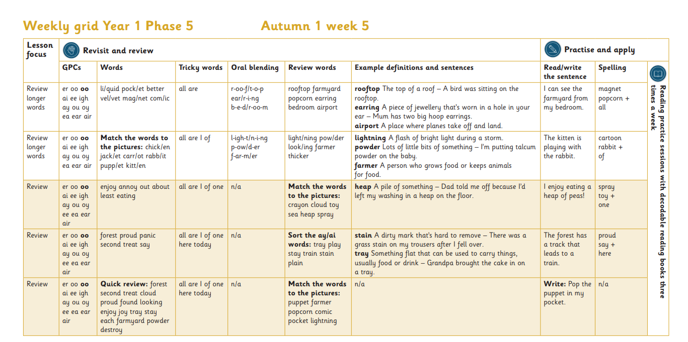
PHONICS
Our Phonics Lessons
Our Phonics lessons use Little Wandle Letters and Sounds
Daily phonics lesson X 5 days
Assessment termly
Homework for practising sounds
Three reads per week; decoding, prosedy and comprehension
In Year 1 children undergo the National Phonics Check!
Notes:
Teachers to add in information about phonics here

Slide 11
READING
Reading in school
Reading challenge
Three reads
Reading lesson 3 times a week
Small groups of six.
Books closely matched to phonic knowledge from LW.
Each week the home reading books are changed on a Wednesday.
Please read at least three times a week with your child and note it in Reading diary.
Focus on decoding; breaking into units of sound
Prosody; reading
with fluency and
expression
Comprehension; what have they understood?
Notes:
Talk through the importance of reading
Year 1 to add in the Bog Cat reading here and the difference in books - to read with parents and to read phonetically.

Slide 12
WRITING
Please encourage children to practise handwriting at home too.
Our lessons
Hand writing
Model text or story-based learning
Grammar focus
Short date and learning objective.
Handwriting lessons 3 times a week
Spellings
Always segment for spelling in phonics lessons using graphemes/phonemes.
Notes:
Edit to fit your class needs

Slide 13
HOME LEARNING
Home learning menu
Spellings
Reading and TTRS
Phonics homework practise
hand in day is Tuesday
Given out on Wednesday
as part of Phonics homework.
We ask that children should be reading at home 3 times a week with an adult.
We ask that children access TTRS throughout the week once logins are set up.
Notes:
Edit to fit your Key Stage

Slide 14
How else can I help at home?
Parents are a child’s first and best
teachers!
Writing shopping lists, diaries, letters in cards
Check correct letter/number formation; start from the correct starting position.
Completing mental maths in shops – working out how much two items may cost, how much change to be expected.
Using analogue clocks in the home – what time is it or setting boundaries using an analogue clock to help them tell the time.
Reading – anything! Asking their opinions on what they have read – diagraph/trigraph detectives/ spotting mistakes in things is a great game to play!
Talking – talking about the news, what is happening in their life exploring opinions and thoughts and feelings.
Notes:
Add and edit appropriately to your phase.

Slide 15
IMPORTANT THINGS TO REMEMBER:
PE Days are Mondays and Wednesdays
Reading diaries should be brought into school every day.
Please name all uniform and property so we can return it if it gets lost.
All the information you get here today can be found on our website: https://www.sacredheart.notts.sch.uk/
Notes:
Edit

Slide 16
Q&A

