Slide 1
Welcome to
Year 2's Parents Meeting!
MRS HAYES – Monday and Tuesday
MRS DAMES – Wednesday, Thursday am and Friday
MISS FULFORD MRS OWEN (Thursday pm)
Notes:
Ensure you have the correct year group on here and the correct staff names.
Welcome the parents, explain that today you are going to run through what class X will be learning this year, where things can be found on the website, how they can help at home.
Explain that after the presentation, you are happy to speak to parents about individual children if they have any concerns or worries.

Slide 2
Behaviour Policy
Sacred Heart Behaviour Curriculum
Politeness Pets
Star Listening
Slow walking
SPEAK
Notes:
In May 2023 we introduced our behaviour curriculum - we introduced slow walking PETS, star listening and this has had an impact in class learning time. However, in June 2024 we reviewed the curriculum and strategies with the children and staff. The pupils and staff agreed that we needed more visuals to help the children see where their behaviour was. We worked with the children and developed the cloud system.
Every child starts everyday on the heart – these represent out heart values of hardworking, enthusiastic, aspirational, respectfulness and togetherness. This is the least we expect off every child.
The start is for exceptional behaviour – always on the heart, helping others, going above and beyond in politeness, effort, care or the school and care of others.
Explain the clouds
Straight to blue for calling a name
Straight to red for hurting others
Three reds and SLT becomes involved and a behaviour plan is created.
Racist and homophobic incidents will automatically involve SLT.

Slide 3
Communication goes through the office.
Teachers can send out messages.
Newsletter is on the website.
PLEASE CHECK ARBOR.
Communication
Notes:
Last year, we worked with a parent party, staff and governors to have a new communication policy. This was to reduce frustration of Dojo messages being missed and so at all times a second person had oversight of messages coming into school.
Arbor is a full communication system. You can send messages and teachers can send messages. Messages sent to the office will be acknowledged and are passed onto the member of staff the same day. If it is an urgent matter, the class teacher will get back to you however if it is non- urgent the class teacher has three days to respond.
Newsletters are sent out every month via email and placed on the website under newsletters. These give you important information regarding what is happening or happened in school and had a diary dates page which is updated monthly.
Please do check ARBOR for messages.

Slide 4
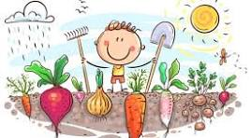
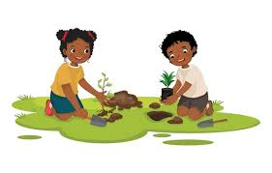
Our SCIENCE TOPIC on PLANTS and GROWING
links into our Gardening in the Spring and Summer.
OUR TOPICS
Goose Fair
Poles Apart
The Great Fire of London
Sensational Safari
Heroes
Sail the Seven seas
Notes:
Add in what are your main topics during the year in here.

Slide 5
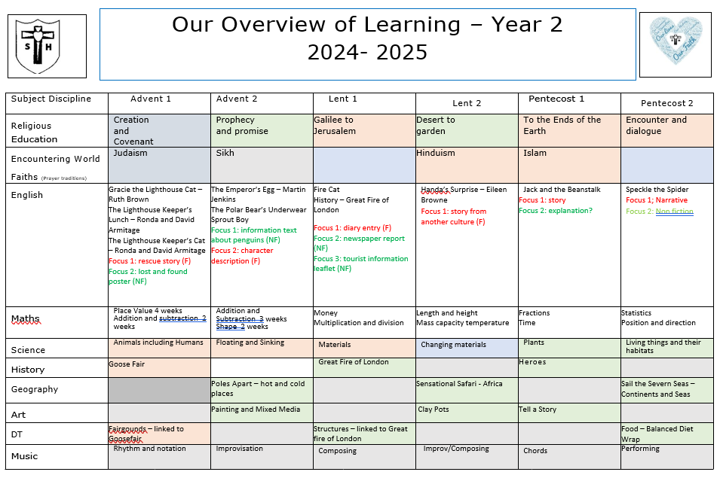
Notes:
Add in snips of your OWN overview. Explain that this can be found on your class page and that further information can be found on the curriculum pages.

Slide 6
Religious Education
We are currently trialing the new Religious Education Directory.
This is a new knowledge-based curriculum that will come into effect nationally in September 2026.

Slide 7
Every year, the pupils will experience the following units
Advent Term
Creation and Covenant
Judaism
Sikhism
Prophecy and Promise
Lent Term
Pentecost Term
Galilee to Jerusalem
Hinduism
Desert to Garden
To the end of the Earth
Islam
Encounter and Dialogue
You will notice an increase in world faiths, this is to link in with British Values, promoting tolerance and respect for different faiths and cultures. In each world faith we teach, we will look at how the faith shows care in the community.
Notes:
Read slide.
We are currently working on parent guides for each year group which will be shared on the schools website.
Explain that the all pupil voice and a national survey completed by the Children’s commissioner has clearly demonstrated that they pupils want to learn more about world faiths too.

Slide 8
MATHS
By the end of Year 2 the children need to know their 2, 5 and 10 timestable.
Times Tables
Our Maths Lessons
Practice counting in 2s, 5s and 10s in class 3 times a week.
Counting assessment at the end of each half term progressing to timetables tests later in the year.
Times tables Rock stars
Flash Back 4
Tough Ten
White Rose
Fluency
Problem solving and reasoning
Small group support
Differentiation/Challenge
Notes:
Explain what a lesson looks and feels like – resources we use – importance of problem solving and reasoning every lesson
Edit where needed for year group/ phase.

Slide 9
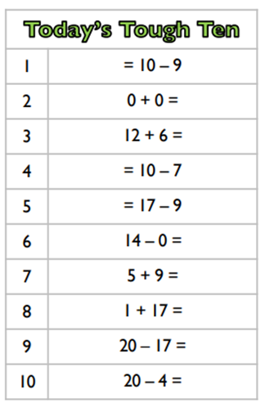

Slide 10
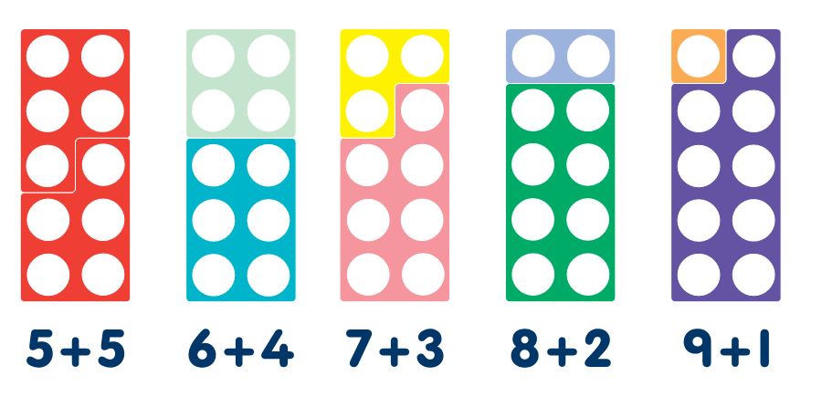
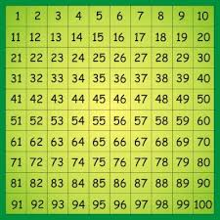
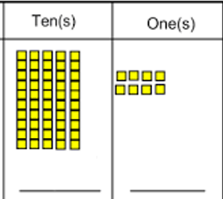
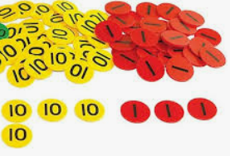
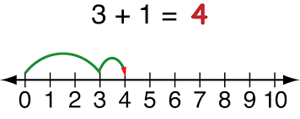
Notes:
Add in snips of your OWN overview. Explain that this can be found on your class page and that further information can be found on the curriculum pages.

Slide 11
PHONICS/SPELLING
20 minute lesson daily following the Little Wandle scheme that the children have been following in F2 and Year 1.
Year 2
Revise Phase 5
Bridging to Spelling
Year 2 Spelling
Spelling lists will be generated from the learning focus of phonic lessons.
Notes:
Teachers to add in information about phonics here

Slide 12
READING
Home Reading
Each week the home reading books are changed on a Wednesday.
The children will have access to books for reading for pleasure during reading time and can bring one home for an adult to read with them.
Reading in school
LOVE OF READING
Guided Reading groups.
Children will read with an adult at least once a week.
Reading will focus on decoding, prosody (expression) and comprehension.
Read to your child.
Encourage your child to read and listen to them as often as possible.
Visit a library.
Read comics, recipes, etc
Notes:
Talk through the importance of reading
Year 1 to add in the Bog Cat reading here and the difference in books - to read with parents and to read phonetically.

Slide 13
WRITING
Please encourage children to take care over their handwriting at home also.
Our lessons
Model text or story-based learning
Story maps
Grammar focus
Independent writing
Handwriting
Handwriting lessons once a week focusing on letter formation and introducing joined up handwriting
Notes:
Edit to fit your class needs

Slide 14
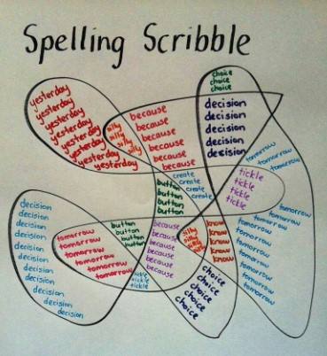
HOME LEARNING
Reading and TTRS
Spellings
We ask that children should be reading at home at least 3 times a week with an adult.
We ask that children access TTRS throughout the week - Numberbots
Given out on a Wednesday
Tested on a Monday
You can find all the spellings on our website under class pages
Please spend 10mins a day to practice these. Use: Look, Cover, Write, Check and Spelling scribbles
Notes:
Edit to fit your Key Stage

Slide 15
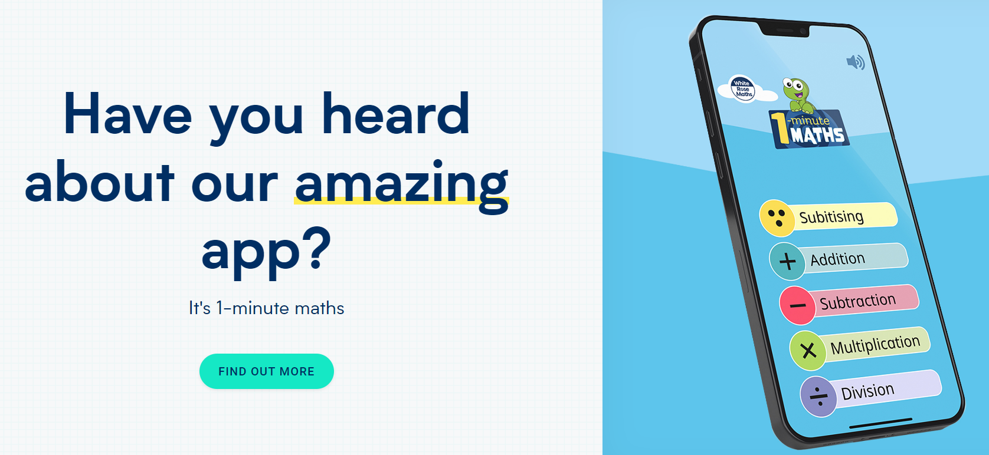

Slide 16
How else can I help at home?
Parents are a child’s first and best
teachers!
Writing shopping lists, diaries, letters in cards
Completing mental maths in shops – working out how much two items may cost, how much change to be expected.
Using analogue clocks in the home – what time is it or setting boundaries using an analogue clock to help them tell the time.
Reading – anything! Asking their opinions on what they have read – spotting mistakes in things is a great game to play!
Talking – talking about the news, what is happening in their life exploring opinions and thoughts and feelings.
Notes:
Add and edit appropriately to your phase.

Slide 17
IMPORTANT THINGS TO REMEMBER:
PE Days are Tuesday and Wednesday
Reading diaries should be brought into school every day.
All the information you get here today can be found on our website: https://www.sacredheart.notts.sch.uk/
Notes:
Edit

Slide 18
Q&A

