Slide 1
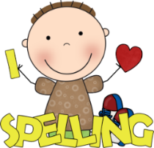
What to bring to school:
Homework:
Please make sure that you have the following things with you in school each day:
Bottle of water
Coat
School reading book
Reading diary
Our PE days will be on Monday and Wednesdays. Please ensure that the correct PE kit is worn. Also, please be prepared for indoor and outdoor PE sessions.
Homework will be set at the beginning of each half term and will cover a range of subjects linked to our overarching topic. Children can choose which activity they would like to do, with the expectation one is completed each week.
We will also be sending home TTRS logins for the children to practice their Times Tables, these should be practiced weekly.
Welcome
to
Year 3!
I hope you have all had a lovely summer break!
We have got lots of exciting topics planned for this year and I am really looking forward to working with you and getting to know you all.
Miss Murray
Spellings:
Reading:
Spelling will be given out every Monday and you will be tested on them on Friday. I would be so grateful if you could set aside some time each week to practice these with your children. There will also be regular spelling sessions in school. The spelling should be stuck into their reading diary by the children, so please check.
It is very important that you read as much as possible, both at school and at home. Don’t forget to record your reading in your reading diary, as we love to see what you have read.
We will have lots of exciting competitions throughout the year to encourage reading!

Slide 2
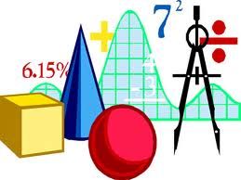
History:
What we
will be
learning:
Computing:
Computing systems and networks
Creating Media -Animation
Our history topic for Advent term with be ‘The Stone Age to The Iron Age’. We will be exploring settlements, hunting and gathering and what impact these historical eras have had on the modern world.
PE:
Dance
Games
Hockey
Gymnastics
Art/D&T:
Maths:
Pre Historic Cave Paintings
Electrical Systems
Number and place value
Addition and subtraction
Multiplication and Division
Music:
Improvisation
Reading Notation
RE:
French:
Creation and Covernant
English:
L’ancienne histoire de la Grande-Bretagne
J’Apprends Le Francis
Our English lessons will be based on a story called ‘The Stone Boy’. We will be looking at writing character description and setting description; looking at how we can use a range of word classes to extend our writing, as well as practising different elements of grammar and punctuation. We will also be exploring explanation texts, informing the reader how to start a fire in the Stone Age.
Science:
Geography:
Animals including humans
Forces and Magnets
Our Geography topic for Advent term will be “What Makes Britain Great?”. We will be exploring the counties, cities and human and physical characteristics that make up the UK.
Advent term 2024

