Slide 1
What to bring to school:
Reading:
Please make sure that your child has the following things with them in school each day:
Water bottle
School reading folder
Reading books and diary
Our PE days will be Tuesday and Wednesday. Please ensure that the correct P.E. kit is worn. Also, please be prepared for indoor or outdoor P.E. sessions.
Year 2!
In Year 2 your child will have their books from the banded reading scheme changed each week on a Wednesday. They will be given two books to last them a week. After hearing your child read please record this by writing a comment in their reading diary.
They will also be able to bring a book home to share with you from the class library, which are chosen for interest and enjoyment. Please read these books with, and to your child, as this will make a great difference to their progress
towards independent reading.
The children need to keep their books in a school reading folder (not rucksack) and bring it into school daily.
We hope you have all had a great Summer break. This leaflet will give you some general information about our routines and the topics we will be working on this half term.
Miss Fulford is the teaching assistants in Year 2. Mrs Owen will also be working in year 2 teaching the class on a Thursday afternoon while Mrs Dames is running Forest School sessions.
If you have any questions or need to speak to us please catch us after school or message the office.
With thanks,
Mrs Dames and Mrs Hayes
Spellings:
This term the children will begin to bring home some spelling lists to learn. More details about this will follow. The spellings will be stuck in a ‘Spellings to Learn’ book and there will be a weekly quiz. We would be grateful if you could spend some time each week helping your child learn these spellings when they begin.
R.E:
Gardening
Our R.E topic this half term is:
Creation and Covenant
The care of the Year 2 garden passes on to the new Year 2s. Further details will follow about gardening days/times.

Slide 2
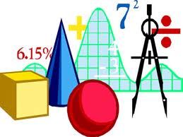
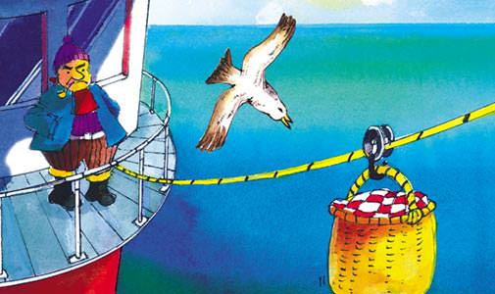
What we
will be
learning:
Topic:
Maths:
Our History topic this half term will be ‘Goose Fair’.
This half term we will be covering the following topics in maths:
Place Value
Addition and Subtraction
We will also have time each week to practice mental maths and general arithmetic skills. To support your child at home please practise quick recall of number bonds an doubles to 15. E.g. 3+5=8 5+3=8 6+6=12 so 12-6 =6
English:
English will be taught through the following books and stories - ‘The Lighthouse Keeper’s Lunch’
‘The Lighthouse Keeper’s Cat’
‘Gracie the Lighthouse Cat’.
Science:
Our Science topic this half term will be Animals including Humans. We will look at the human life cycle and what happens at each stage of development. We will then look at the lifecycle of another animal.
Computing:
Music:
Art and Design and Technology:
In the first half term we will explore Computing systems and networks IT around us
Our Art and Design Technology topics will be taught by Mrs Owen on a Thursday afternoon while I am leading Forest School sessions. The theme is: Drawing – tell a story
Music will continue to be provided by teachers from Christ The King. The focus will be Rhythm notation
Autumn - first half term 2024

