Slide 1
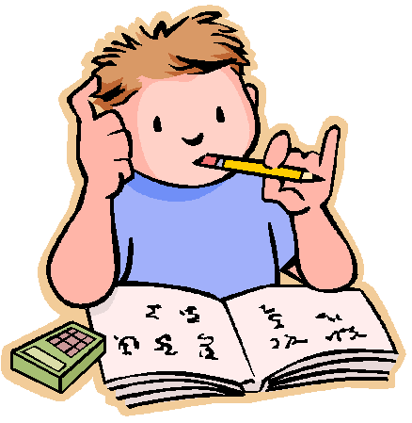

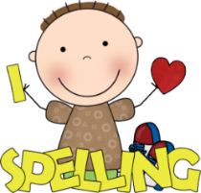

What to bring to school:
Homework:
Please make sure that you have the following things with you in school each day:
Bottle of water
Coat if needed
School reading book
Reading/homework diary
You will each be given a homework ‘menu’ at the beginning of each half term. Each week, you can choose which option you would like to do. Homework should be brought into school on a Monday.
Dates for your diary
Briars:
Wednesday 25th – Friday 27th September
DART graduation:
Monday 2nd December @ 2:30pm
SATs week 2025:
Monday 12th – Thursday 15th May
Welcome
to
Year 6!
I hope you have all had a lovely summer break!
We have got lots of exciting topics and trips planned for this year and I am really looking forward to working with you and getting to know you all.
Miss Armstrong
Spellings:
Spelling will be given out every Monday and you will be tested on them on Friday. You must make sure that you set aside time to practise them at home. There will also be daily spelling sessions in school.
Reading:
This year, it is very important that you continue to read as much as possible, both at school and at home. This should be recorded in your reading diary.
Our PE days are Wednesday and Thursday. Come to school in your PE kit on these days.

Slide 2
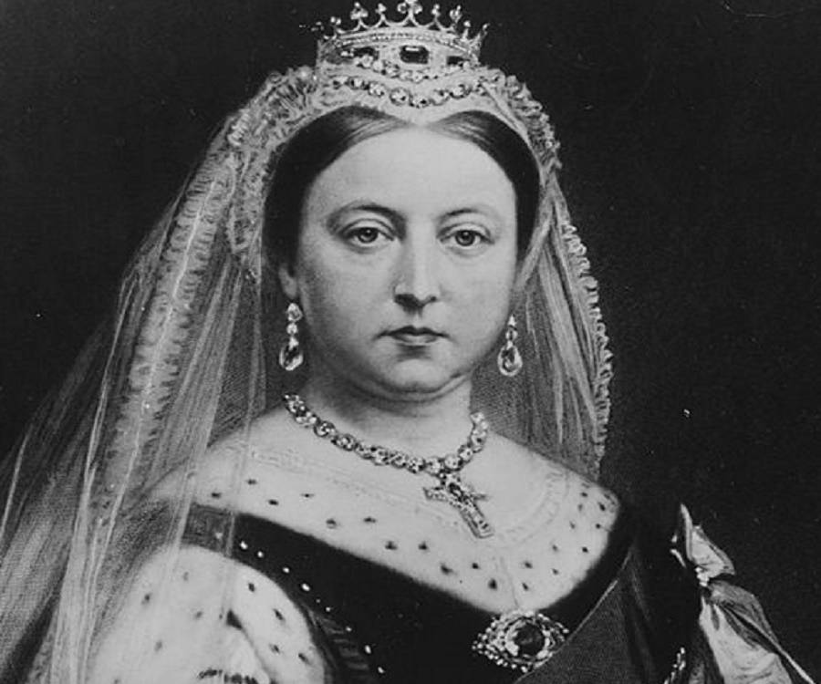
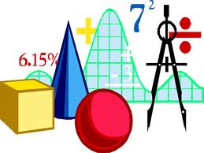

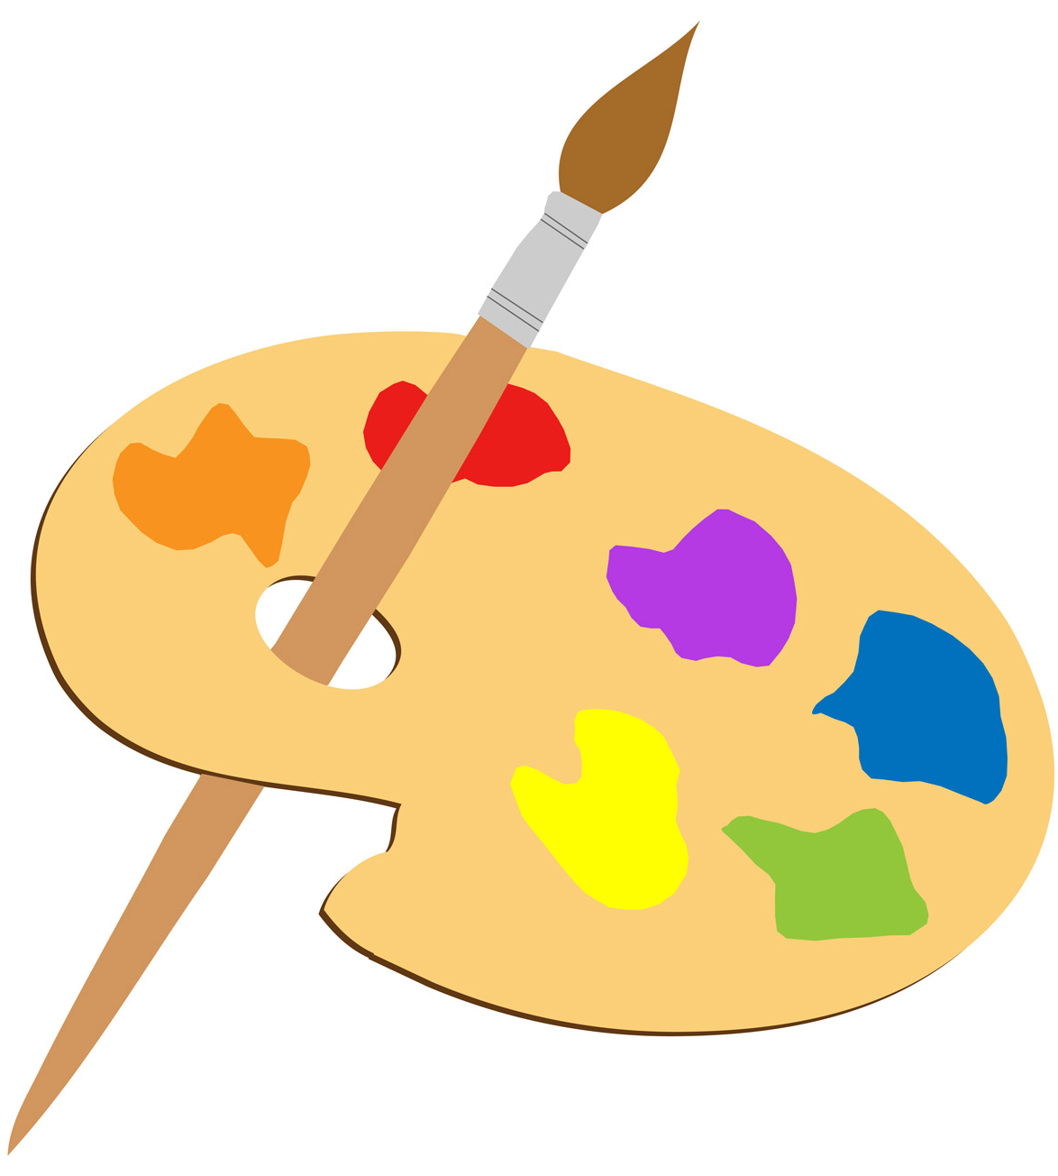


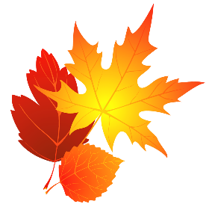
History:
What we
will be
learning:
Maths:
The Victorians – Rich and poor:
Homes and houses
Children’s jobs
Workhouses
Impact of social class
Number and place value
Addition and subtraction
Properties of shapes
Multiplication and division
Fractions, decimals and percentages
Position and direction
Measurement (length and time).
We will also have time each week to practise times tables, problem solving and general arithmetic skills.
Geography:
The Amazon Rainforest:
Layers of the rainforest
Plants and animals
Deforestation and its impact
The Amazon River
Art and D&T:
Portraits
Structures: Bridge across the river
English:
RE:
Computing:
Advent 1: Street Child by Berlie Doherty
Story set in the Victorian Era
Biographies
Advent 2: The Explorer by Katherine Rundell
Adventure story
Non-chronological reports
Creation and Covenant
Prophecy and Promise
Computing systems and networks
Communication
Creating media
3D modelling
Science:
The heart and circulatory system
Light
Music:
French:
Ostinato
Scales, arpeggios and chords
At school
Me in the world
Advent term 2024

