Slide 1
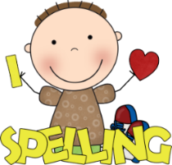
What to bring to school:
Homework:
Please make sure that you have the following things with you in school each day:
Bottle of water
Coat
School reading book
Reading/homework diary
You will each be given a homework ‘menu’ at the beginning of the year. Each week, you can choose which option you would like to do. Homework should be brought into school on a Monday.
Briars:
Wednesday 20th – Friday 22nd September
Year 6 Holocaust Day:
Monday 13th November
SATs week 2024:
Monday 13th – Thursday 16th May
Welcome
to
Year 6!
I hope you have all had a lovely summer break!
We have got lots of exciting topics and trips planned for this year and I am really looking forward to working with you and getting to know you all.
Miss Armstrong
Spellings:
Spelling will be given out every Monday and you will be tested on them on Friday. You must make sure that you set aside time to practise them at home. There will also be daily spelling sessions in school.
Reading:
This year, it is very important that you continue to read as much as possible, both at school and at home. Don’t forget to record your reading in your reading diary.

Slide 2
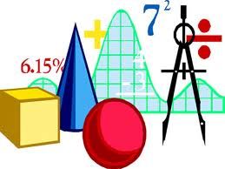
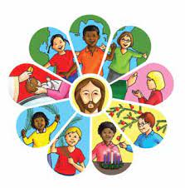
History:
What we
will be
learning:
Maths:
The Victorians – Rich and poor:
Homes and houses
Children’s jobs
Workhouses
Impact of social class
Number and place value
Addition and subtraction
Properties of shapes
Multiplication and division
Fractions, decimals and percentages
Position and direction
Measurement (length and time).
We will also have time each week to practise times tables, problem solving and general arithmetic skills.
Geography:
The Amazon Rainforest:
Layers of the rainforest
Plants and animals
Deforestation and its impact
The Amazon River
Art and D&T:
Painting and mixed media
Structures: Bridge across the river
RE:
English:
Loving
Judaism
Vocation and Commitment
Expectations
Computing:
Our English lessons will be based on a book called ‘Street Child’, about a young boy living in the Victorian times. We will be practising lots of different grammar and punctuation techniques, and will finish the unit by writing Jim’s biography.
Computing systems and networks
Communication
Creating media
3D modelling
Science:
The heart and circulatory system
Light
Music:
French:
Ostinato
Scales, arpeggios and chords
At school
Me in the world
Advent term 2023

