Slide 1
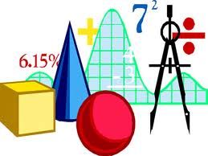
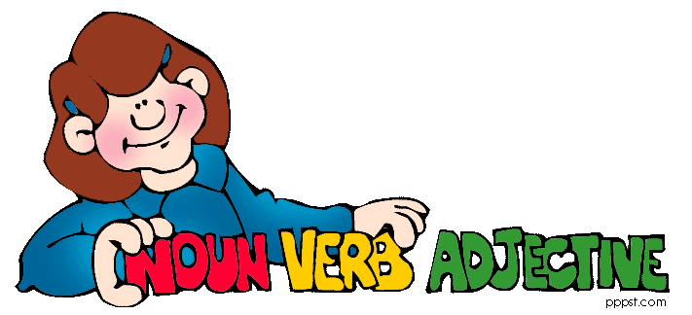
Topic:
Maths:
Happy New Year!
Welcome back! I hope you have had a fantastic Christmas and are ready for another term of hard work!
As well as continuing with our usual lessons, we will also start doing some SATs practice papers in preparation for the tests in May. Our booster sessions will be running on a Wednesday to give us some extra practice for the papers.
Miss Armstrong
Our topic for the first half term is the Anglo-Saxons. We will be using primary and secondary sources to find out about how they invaded and settled in Britain, what their houses looked like, and much more!
This term, we will be covering the following topics in maths:
Negative numbers
Time
Algebra
Angles
Multiplication
Division
Decimals and percentages
Ratio and proportion
Mass
Area and perimeter
We will also have time each week to practice mental maths, problem solving and general arithmetic skills.
English:
In English, we will be reading Michael Morpurgo’s version of the old Anglo-Saxon tale of Beowulf and using it to help us write our own stories.
SPaG:
Computing:
We will continue to have short SPaG (spelling, punctuation and grammar) lessons each week, as well as focusing on grammar and punctuation within our English lessons
We will continue to add to our coding skills, using different programs to create our own apps and games. ICT will also be integrated into many of our other lessons.
Lent term 2023

Slide 2
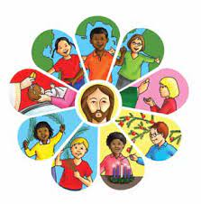
History:
Lent term 2023
Maths:
Crime and Punishment:
How do we know if someone is guilty of a crime?
How have punishments changed over time?
How can we prevent crimes from happening?
Ratio
Algebra
Decimals
Fractions, decimals and percentages
Area and perimeter
Volume
We will also have time each week to practise times tables, problem solving and general arithmetic skills.
Year 6
Geography:
Happy New Year!
Welcome back! I hope you have had a fantastic Christmas and are ready for another term of hard work!
Miss Armstrong
The British Empire:
What was the British Empire?
What was the human impact of the British Empire?
Why did the British Empire collapse?
What is the commonwealth?
Computing:
Creating media
Data and information - spreadsheets
English:
Our English lessons will be based on a story called ‘Beowulf’ written by Michael Morpurgo. We will be learning how to write vivid character and setting descriptions, creating news reports and using figurative language.
RE:
Music:
Sources
Unity
Death and new life
Trailblazers
Samba music
French:
Art:
Science:
At the weekend
Regular verbs
Photography
Classification
Electricity

