Slide 1
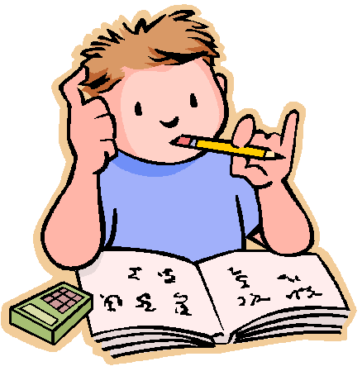
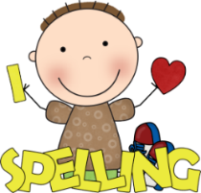
What to bring to school:
Homework:
Please make sure that you have the following things with you in school each day:
Bottle of water
Coat
School reading book
Reading/homework diary
Homework will be sent home on a Friday and is to be handed in on Monday mornings. If there are exceptional circumstances which mean that you can’t do your homework at the weekend, I will need a message from your parents to explain why.
Briars:
Monday 3rd – Wednesday 5th October.
SATs week 2023:
Monday 8th – Thursday 11th May.
I will send out more information regarding the tests in the coming weeks.
Welcome
to
Year 6!
I hope you have all had a lovely summer break!
We have got lots of exciting topics and trips planned for this year and I am really looking forward to working with you and getting to know you all.
Miss Armstrong
Spellings:
Spelling will be given out every Monday and you will be tested on them on Friday. You must make sure that you set aside time to practise them at home. There will also be daily spelling sessions in school.
Reading:
This year, it is very important that you continue to read as much as possible, both at school and at home. Don’t forget to record your reading in your reading diary.

Slide 2
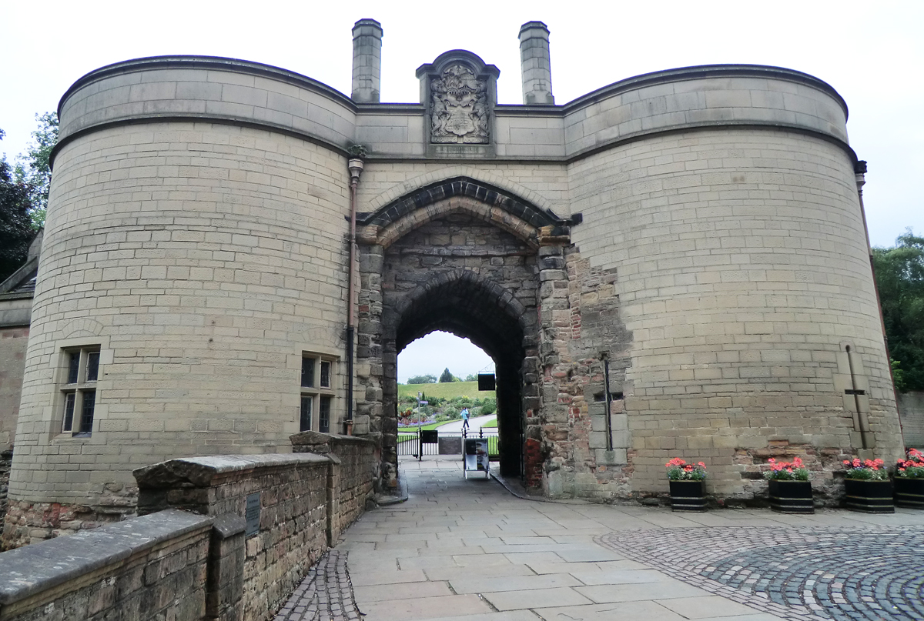
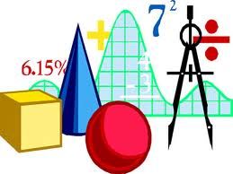
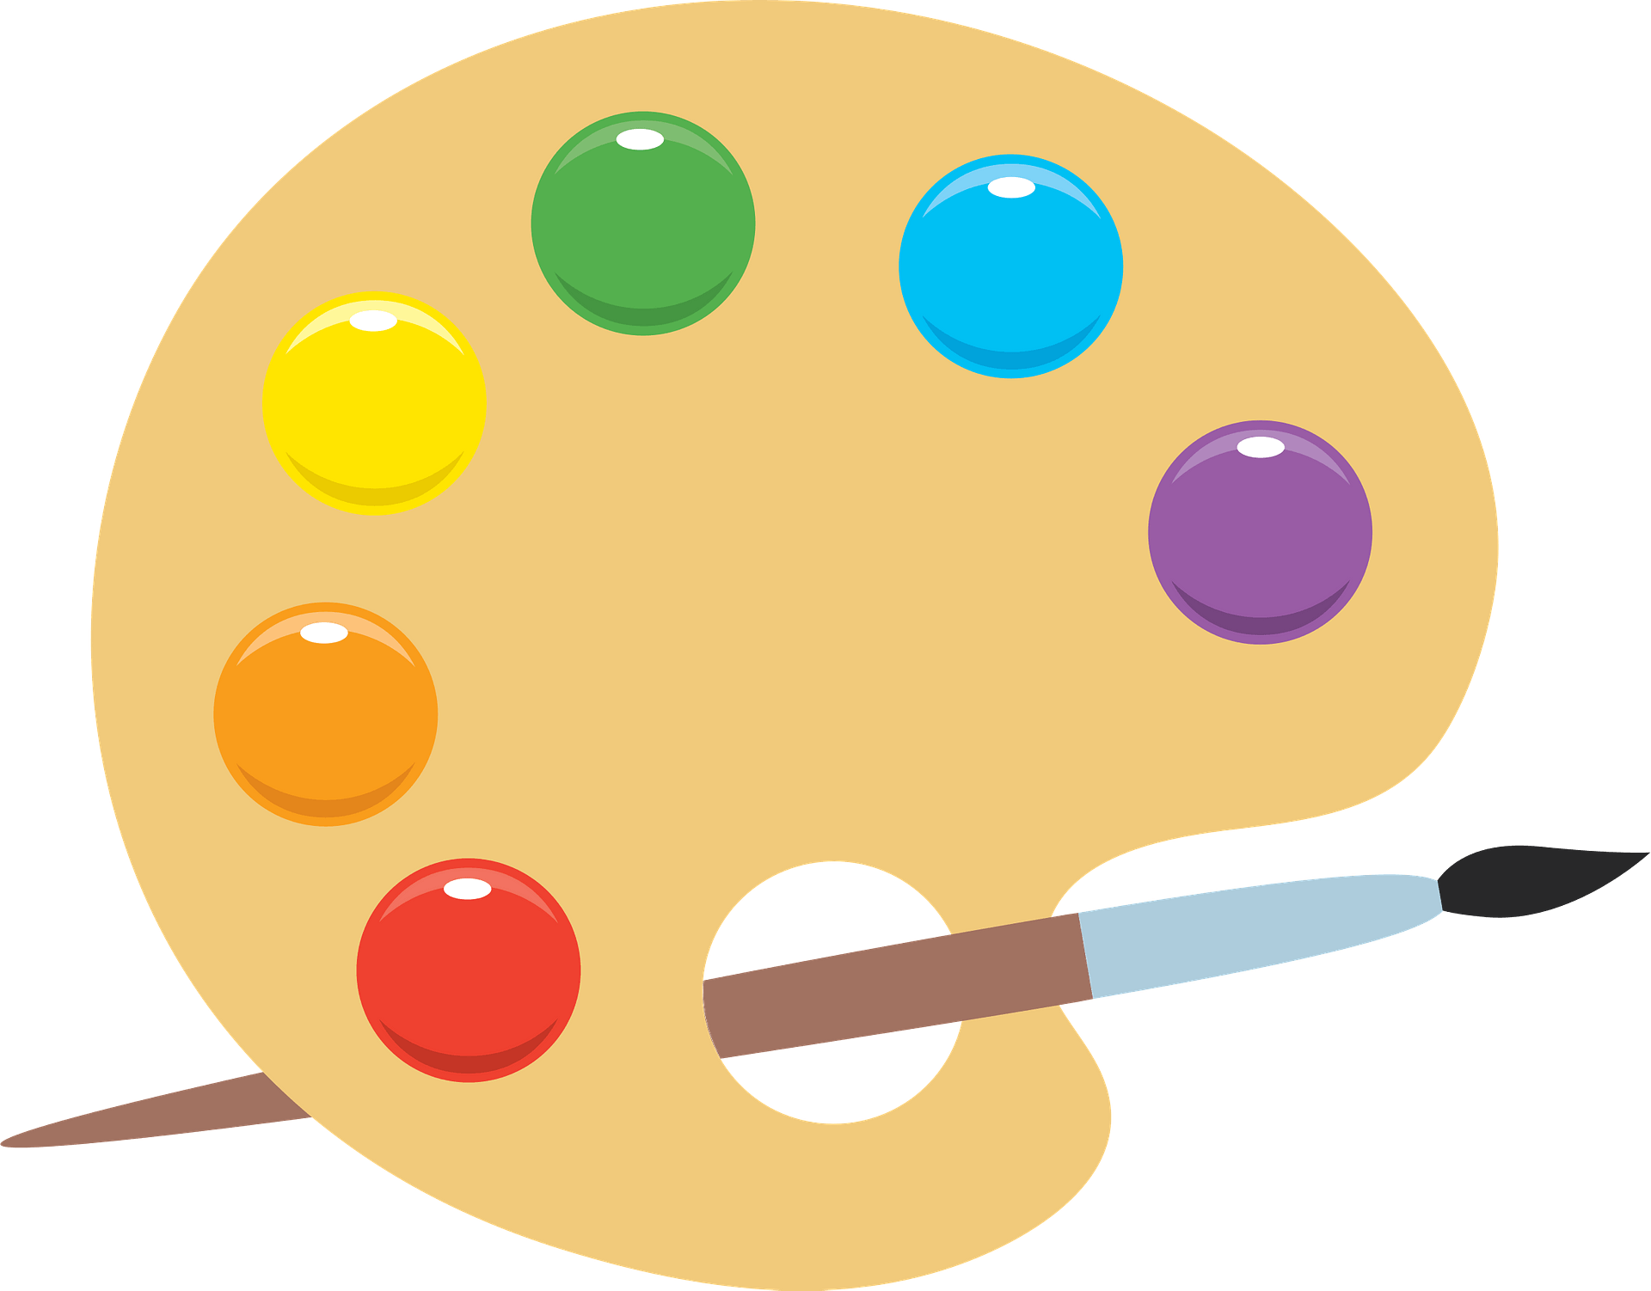
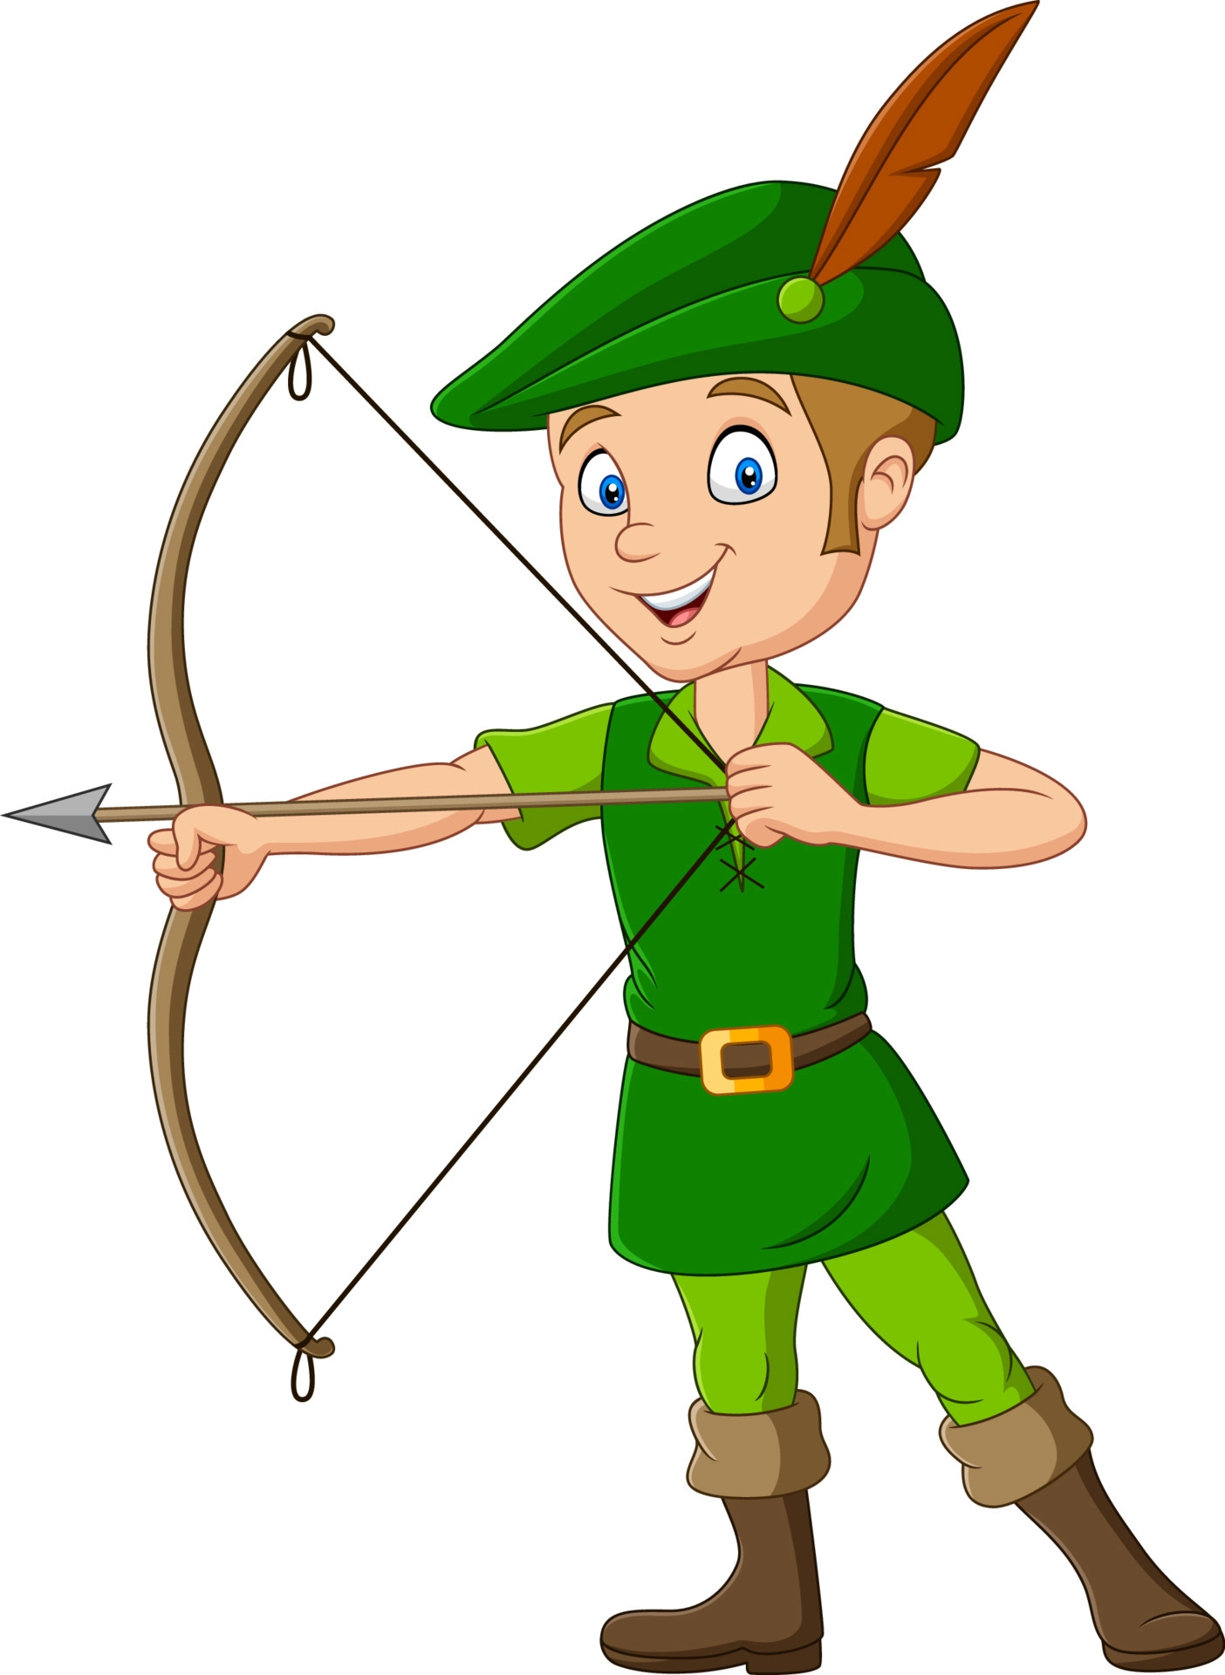
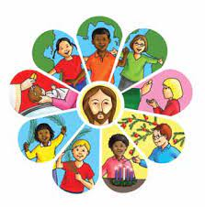
History:
What we
will be
learning:
Maths:
Nottingham:
What was life like in Medieval Nottingham?
What was the impact of WW2 on Nottingham?
How has Nottingham adapted and changed over time to reflect our rich and diverse heritage?
Number and place value
Addition and subtraction
Properties of shapes
Multiplication and division
Fractions, decimals and percentages
Position and direction
Measurement (length and time).
We will also have time each week to practise times tables, problem solving and general arithmetic skills.
Geography:
Art:
Europe:
What countries make up Europe?
The European Union
Map skills
Still life
Formal elements of art
RE:
Loving
Judaism
Vocation and Commitment
Expectations
Computing:
English:
Computing systems and networks
Communication
Creating media
3D modelling
Our English lessons will be based on a story called ‘Trapped’, all about Robin Hood and his friends. We will be learning to write suspense stories, as well as practising different elements of grammar and punctuation.
Science:
The heart and circulatory system
Light
Music:
French:
Ostinato
Scales, arpeggios and chords
At school
Me in the world
Advent term 2022

