Slide 1
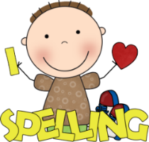
What to bring to school:
Homework:
Please make sure that you have the following things with you in school each day:
Bottle of water
School reading book
Reading/homework diary
Our PE days will continue to be Tuesday and Wednesday. Please be prepared for indoor or outdoor P.E.
Year 4!
This term, I am changing the homework a little bit to enhance our topics and allow the children to be creative. There will also be the Explore homework for R.E at the start of each new topic.
A belated Happy New Year and a huge thank you for the lovely gifts and well wishes over the Christmas period.
During this Lent term, we have had a great start to our work and I am really proud of how you are working in Year 4. We still have lots to do but also lots of fun to be had.
Miss Owens
Easter Production
Later on in the term, Year 3 and Year 4 will be rehearsing hard for their Easter production.
Spellings:
Reading:
Spelling lists will be handed out every Monday and you will be tested on the Friday of the same week. Thank you for all the hard work that has been put in at home to learn the spellings. You must learn your spellings, so make sure that you have plenty of time set aside to practise them. Please take them home so that adults at home can help you too.
This term, it is very important that you continue to read as much as possible, both at school and at home. Don’t forget to record your reading in your reading diary. I know lots of you have been enjoying the class novel at the end of the day. Continue to enjoy reading and why not explore a new genre of book!

Slide 2
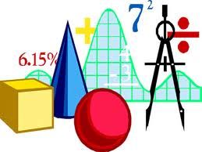
History:
What we
will be
learning:
Maths:
Our topic this term is ‘The Romans in Britain’. We will be exploring the expansion, power and organisation of the Roman Empire, reasons why the Romans came to Britain (and why they left) and how they have influenced our society today.
This term, we will be covering the following topics in maths:
Multiplication and division
Decimals and Fractions
Length and Perimeter
We will also have time each week to practice mental maths, multiplication tables and general arithmetic skills.
Another focus will be on vocabulary to enable children to develop their reasoning skills. Please practise your multiplication tables knowledge ready for the Multiplication Tables Check at the end of Year 4. Remember, practise little and often!
Geography
After half term, our topic will be Settlements. We will link it to our previous topic, ‘The Romans’ and also focus on Nottingham and how the city has developed over time.
Science:
Our Science topics this term will be Sound, where we will explore how sounds are made, how they travel and how they can be changed. Our second topic, Electricity will look at the different components of a circuit and their job within a circuit.
English:
Our main English lessons will be based around the text ‘Julius Caesar’ by Andrew Matthews and ‘Coming to England’ by Floella Benjamin. We will explore various genres of writing including narrative, diary writing and information texts and choosing our vocabulary very carefully to really hook the reader in.
Computing:
We will be looking at photo editing and the skills involved in this. In our second topic, we will be using programming to create repeating patterns. An extremely important part of our computing curriculum will be e-safety.
French:
R.E:
Our French topics this terms will be Les Romains and La Famille. We will continue to consolidate vocabulary already learnt and develop our skills of speaking, listening reading and writing in French.
Our R.E topics this term will be: Community, Giving and Receiving and Self-Discipline. We will explore a range of scripture, making wider links between these and a range of sources.
Spring term 2023

